Slide 1
RESEARCH METHODOLOGY IN A NUTSHELL
Dr. Lakshmi Narayana Shenoy
Asst. Director
Govt. Ayurveda Research Center
Mysore

Slide 3
Bharat Ratna Prof. C.N.R. Rao, a great Researcher
Bharat Ratna Prof. C.N.R. Rao, is an renowned Indian chemist who has worked mainly in solid-state and structural chemistry.
He served as the Head of the Scientific Advisory Council to the Prime Minister of India. He has honorary doctorates from 60 universities from around the world.
He has authored around 1,500 research papers and 45 scientific books.

Slide 4
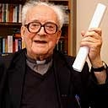
Oldest person to get Ph.D.
Edgar Douse, aged 93 (literally aged), is the oldest person in the world to get a Ph.D

Slide 5
Research is to read what is still unread
A persistent and age-old instinct makes us want to wander Into regions yet untrod
And read what is still unread In the manuscripts of God. — Willis R. Whitney

Slide 6
Research
It is the systematic study of trend or event which involves careful collection, presentation, analysis and interpretation of quantitative data or facts that relates man’s thinking with reality

Slide 7
Good Research : Do lot of Research

Slide 8
WHAT IS RESEARCH?... EINSTEIN
Developing a new theory is not like bringing down an old building and erecting a new sky-scraper in it place.
It is like climbing a hill.
As we go up, the horizon of our view expands and we see many new relations between our starting point and present position.
The starting point doesn’t disappear.
But it appears smaller and smaller as we go higher and higher.
It will still be a part of our new view.
It is not possible to separate or destroy it.
It is only one side of the coin when we say that we have developed a new theory.
In fact, the discovery of limits and imperfections of the old theory is the other side of the coin.

Slide 9
Why Research & Creativity are Important to India’s Future ?
Innovation
Education Science Research Creativity
Economy
New Business
New Jobs

Slide 10
Character 1
Must be open minded and must also adopt a critical way of thinking.

Slide 11
Research solved in a man's head
A research problem is not solved by apparatus; it is solved in a man's head. — Charles F. Kettering

Slide 12
Character 2
Should be hardworking, diligent, focused and devoted to the specific field of interest.

Slide 13
Character 3
Updating the knowledge is of utmost importance and can be accomplished in several ways such as:
following the current literature,
attending conferences,
or exchanging ideas with colleagues working in their field of interest.

Slide 14
Character 4
Must be resourceful and inventive in order to
transform the scientific queries and hypotheses
into a realizable protocol.

Slide 15
Watson : breakthroughs in research
Formula for breakthroughs in research:
Take young researchers, put them together in virtual seclusion,
give them an unprecedented degree of freedom and
turn up the pressure by fostering competitiveness. — James Watson

Slide 16
Character 5
Has to acquire an excellent knowledge of
the Measurement tools and
techniques of the relevant field.

Slide 17
Character 6
When interprets and presents results, the researcher must be precise and honest.
Misinterpretation or falsification of data will not only lead to
deviation of future result and also
invalidate the future research works.

Slide 18
FLEMING: Never neglect an extraordinary appearance
I have been trying to point out that in our lives chance may have an astonishing influence and,
if I may offer advice to the young laboratory worker, it would be this—never neglect an extraordinary appearance or happening.
It may be—usually is, in fact—a false alarm that leads to nothing,
but may on the other hand be the clue provided by fate to lead you to some important advance.
— Sir Alexander Fleming

Slide 19
Character 7
Although there is no need to be a statistician, the researcher has to be aware of basic mathematical and statistical principles in order
to be able to appreciate and interpret results, up to a certain level,
and to study critically the findings of other research works.

Slide 20
Pandora’s box opens now
Now it is time to grab it or ?
!
It is now or never

Slide 21
Parameters in modern research
1. Identify the problem
2. Need of the study
3. Enumerate the present status
4. Methodology
5. Data collection
6. Presentation of data
7. Analysis of data
8. Results
9. Discussion
10. Summary
11. Conclusion
12. Abstract
13. Reference/Acknowledgement

Slide 22
Ayurveda
Modern Research methodology
1. Identify the problem
2. Need of the study
3. Enumerate the present status
4. Methodology
5. Data collection
6. Presentation of data
7. Analysis of data
8. Results
9. Discussion
10. Summary
11. Conclusion
12. Abstract
13. Reference/Acknowledgement
1. Identify the problem
2. Need of the study
3. Enumerate the present status
4. Methodology
5. Data collection
6. Presentation of data
7. Analysis of data
8. Results
9. Discussion
10. Summary
11. Conclusion
12. Abstract
13. Reference/Acknowledgement

Slide 23
Concept of Rasa Vada in Ayurveda
1. Identify the problem
2. Need of the study
3. Enumerate the present status
4. Methodology
5. Data collection
6. Presentation of data
7. Analysis of data
8. Results
9. Discussion
10. Summary
11. Conclusion
12. Abstract
13. Reference/Acknowledgement
1. Classification of rasa
2. Identify the different stakeholders of Darshanas
3. Different scholars assembled in one point to discuss about rasa
4. Invitation to scholars based on different school of thought and different zones of India, a randomly selected non biased approach.
5. Different scholars asked to present their views and data thus collected.
6. Data presented in a seminar
7. Analysis of data done by Atreya
8. Results announced by Atreya by inclusive & exclusive method.
9. Discussions were noted down
10. Atreya Summarized the whole proceedings.
11. Shadrasa siddanta
12. Shadrasa

Slide 24
Concept of research
D + T+ | D- T-
D+T – | D-T+
If ‘D’ is disease and ‘T’ is treatment,
Which is more favorable area for research?

Slide 25
Classification of research
D + T+ Controlled design, comparative design Blinding design Black box design Analytical design | D- T- Logical Analysis Design Innovative designs Computer aided designs
D+T – New drug research area | D-T+ Area of literary research

Slide 26
Bird’s eye view of research
If you answer these 8 questions the whole research concept is completed.
1. What is the research about?- Introduction
2. What is already known in this area? – Literary Review
3. What do I expect to find? – Research question
4. How you went about your research /Approach to the problem? – Research methodology
5. What you found? – Results
6. What do the results finding mean? – Discussion
7. So what / applications/contributions? – Statistical significance
8. What more to future? – Recommendation
Summarize all the findings - Summary.
Simplify all - Abstract

Slide 27
Myths of research in Ayurveda
1. Aptha vachana
2. Siddanta cannot be changed
3. Ayurveda is Nithya
4. Brihmasmritya Ayurveda
5. “Yat iha asti tat anyatra, yannye asti na tat kwachit”
In the above scenario can we move towards research principles.

Slide 28
Concept of Population & sample
Apta vachana: It is not changeable, it is always true and does not have a time limit, so as population or universe.
Based on apta vachana, samples can be drawn and research is done on sample and not on population.
Apta vachanas are targeted over a concept for that time period without any bias, so rajastamobyam nirmuktaha means it is unbiased.
Here randomization is also followed, hence it is not changeable for that time period only.

Slide 29
Concept of subjective and objective parameters
Samanya-Vishesha Siddanta
Here there are 2 definitions are there:
“Samanyam ekatva karam, vishesastu viparyaya”.
“Vriddhi samanai sarvesham, vipareetai viparyaya”.
Eka refers to 1, which is a objective parameter
Vriddhi and kshaya refers to quality which is a subjective parameter.
Hence definitions are subjective and objective parameter oriented.

Slide 30
Selection based on randomization
Invitation to vada parishat
Scholar selection methodology: 2 methods
Based on geographical location Eg: Magada, kalinga. Kousala
Based on different school of thoughts Eg: Scholars from nyaya darshana, sankya & mimamsa darshana
Hence the selection is non biased and randomized.

Slide 31
Synopsis writing ‘made easy’

Slide 32
Title of the synopsis
Title should have compulsory three component
1.problem
2.Solutions
3.Design of the study
Remember: T=P+S+D,
here, Permutations are like this
T=D+P+S
T=P+D+S
T=P+S+D
You can also interchange P & S depending upon your Cathy title

Slide 33
How to write synopsis
Need for Study
Review of literature
Objectives of the study
Materials & methods
Source of data
Literacy source
Sample
Methods of collection of data
Study design
Inclusion criteria
Exclusion criteria
Statistical Methods
Requirement of any investigation or introversion to be conducted on patient or other animals
Requirement of ethical clearance
List of reference

Slide 34
Need of Study
Introduction should be simple
Define the problem with the reference
Enumerate the status of the problem
Statistical importance of the problem in a chronological order
Present status of the problem
Justification in the form of need of the study
SWOT analysis of the problem
Probable outcome of the problem
All these should be within 150 words
It includes hypothesis also

Slide 35
Methodology
Discuss about design of the study
Method of collection of data
Presentation of data
Analysis of data
Special attention should be given on collection about source of data and randomization
Obtaining the results
Analysis of results
Discussion on results
Summary of results
Conclusion
Abstract

Slide 36
Results
Only interpretation of data
Nothing can be put from the pockets
No analysis work here
If it is negative don’t make it positive
Even a negative result is significant in research
Results should not be tampered, fabricated, biased. It should be specific to the problem analysis.
All inferences should be presented precisely in tabulation and graph form.
If it is needed photographs and illustrations may be permitted.

Slide 37
Discussion
Discussion should be based on literary review and results
Discussion should be imperative if there is a difference between literary and obtained results
Discussion should be aimed to rectify or justify depending on the situation
It should be within 3-5 pages, always should be in passive voice and avoid usage of words, I-Me-My.
Discussion should be critical, own experiences may be added here, preferably discuss more on strength and weakness of the study.
Discuss about the previous work (Literary review)and implication (Present study) of this work and scope for future work (citations).

Slide 38
Conclusion
This is one area where researcher really puts his views in the form of logical analysis, analytical analysis or innovative analysis or intuitional analysis.
Conclusion should draw solution to the problem or alternative solution to the problem, may be in a positive or negative way.
Negative conclusions are also important in research, where it gives idea of negativity.

Slide 39
Summary
Summarize the whole event
Summary should be apt and simple
There is no discussion in the summary
The whole event / fact should be discussed in a chronological order specifically and methodically.
Summary should be in present tense and importance should be given to silent findings.

Slide 40
Abstract
Abstract is nothing but shorter form of the summary
Abstract should be within 300 words or within 1 or 2 pages and should be in present tense.
It is not merely a summary or project report, it should clearly indicate the judgment of the researcher and give a solid stand for his answer to the problem.
Abstract is mirror of whole project and if somebody reads the abstract thoroughly he should have a glance of whole project.
Key words are important characteristics of abstract.

Slide 41
Reference writing
There are two styles of reference writing, one is Vancouver style and other one is Harvard style

Slide 42
Acknowledgement & Appendix
Acknowledge and recognize guide, co guide, faculty and others who are specific contributors in the study in a chronological order.
Appendix should include important documents of data collection, photographs and other materials which are important in the study.

Slide 43
Seminar question
Can we infer that modern scientists borrowed the concept of research methodology unknowingly from Ayurveda
???
If yes
If no
Please give your inputs ayurvedaresearch2017@gmail.com

Slide 44
Clinical research comment:
A clinical research project is designed on the basis of ‘yukti’ - a systematic, intelligent arrangement of thought based on ‘aptopadesha’ - known facts about the topic; conducted ‘pratyaksha’ - in specified precise setting; with ‘anuman’ - expected outcome or inference. When the work is complete it can be added to ‘Aeitihya’-a written document.
There are no references to the designs like, randomised controlled trials or longitudinal methods but the theme method can be co-related to case control studies which are now being supported by WHO considering individuality. Also keeping the meaning at the core intact, new thinking can be developed

Slide 45
Drug Research Examples:
The formulation Pippali ksheera, that is piper longum processed in milk is advised and not pippali kashaya.
Use of centella asiatica juice, glycerrhiza glabra powder or convolvulus pluricaulis paste with milk to achieve the Medhya effect, points out that a particular dosage form along with a particular anupana is administered to achieve a specific pharmacological action is nothing but a conclusion after research.
Another example comes from a later text like Bhavprakash. Chopchini [Smilex china] a plant of Chinese origin is identified for its rasa, veerya, vipaka guna and Karma. Its action is best seen in powder form than decoction in inflammatory conditions of joints and second or third stage of veneral diseases.

Slide 46
Drug Research Comment:
At this point it is a must to note that the understanding of Ayurveda with respect to Drug quality assurance, toxicity, antidotes, and efficacy is similar to current understanding.
The development of dosage forms like parpati or pottali are concrete examples of drug development process through research where herbs and minerals-metals are processed together.

Slide 47
Literary research Comment:
The techniques described or factors considered for literary research seem complex in modern days because of the main constraint of limited availability of writing materials, which is responsible for preparation of a few copies of manuscripts of any book.
It must have been quite a worth brainstorming exercise to express the content in a well structured -mainly poetic- form without hampering the exact shade of meanings. Today writing, printing and publishing has become easily accessible and affordable to common man.
The extra efforts of using poetic form are reduced but the basic principle of correct usage of terminology, sentence construction, grammatical correctness and expression in minimum possible words to convey a scientific invention and discovery remains the same. This places Ayurveda on higher pedestal as best example of medical literature.

Slide 48
Epidemiological Research Examples:
Best food article from a group of similar articles or best drug having the desired effect amongst drugs having the similar effect can not be decided unless a large number of population has shared same experience or shown same type of result.
Also most harmful fish is ‘Chilchim’ or eating fish and milk together leads to skin disease are the outcomes which can be generated only after many observations put together.
Effect of pollution of environmental factors like air, water, soil and the measures to be adopted in such conditions to maintain health of people is an example of epidemiological study.

Slide 49
Epidemiological Research Comment:
It seems that the present methods of epidemiological research, observation and inquiry were used with both approaches prospective and retrospective.
When the suggestions like ‘what dietary and behavioural pattern an expecting couple should practise if a typical progeny is expected’ are written then it is indicative of prospective one.
Similarly all pitta predominant prakriti people suffer from blood disorders if they indulge themselves with hot tasted foods, alcohol consumption, work under burning Sun for a considerably long period is a prospective kind of study.
In case of guidelines of predicting death of a suffering person, or effects of viruddha ahara in developing certain skin conditions; the approach is retrospective. This statement one can make because the science that propounds ethics in use of plants would not try harmful things on humans.
The section of Charaksamhita where these observations are recorded categorically is titled as ‘Indriyasthana.’

Slide 50
Fundamental Research Examples:
The twelfth chapter in Charaksamhita titled ‘Vatakalakaleeya’ explains the functional types of Vata dosha but does not elaborate on types of remaining two doshas. About a millennium later Ashtanghridaya elaborates Pitta dosha and Kapha dosha in similar fashion. The hypothesis is ‘Pitta and Kapha can also be classified on the basis of functionality’.
The 63 permutations and combinations arising from six ‘Rasas’ explained in Charaksamhita are cross-matched with 63 permutations and combinations originating from three doshas in Ashtangasamgraha.
The debate about number of rasas documented in Atreya-Bhadrakapyeeya chapter of Charaksamhita underlines that fundamental principle regarding the number of ‘Rasa is six’ was challenged and various hypotheses like rasa are two, three or eight were tested on the above mentioned parameters with a conclusive justification by rishi Atreya that rasas are six.
Similarly Dalhan at one place proposes that ‘rakta’ should be considered fourth dosha which is debated upon by others and ‘doshas are three’ is confirmed.

Slide 51
Fundamental Research Comment:
Principles of Fundamental research explain the method of science. How to analyse and understand any unknown fact is elaborated in this method.
Most important fact is that the principles have not changed over last thousand of years and the change in application is also not very drastic.
What has changed is development of technologies which aid ‘pratyaksha’ and enable oneself to acquire knowledge directly which was not possible before.

Slide 52
Importance
Provides health related quality life.
Provides confidence in speech-Vaaksoushtave.
Understanding of cause and effect relationship-Arthavijnaane.
Knowledge and confidence - Pragalbhata
Expertise in surgical/para sugical and nonsurgical-Karmanaipunya.
Re-establish faith in Ayurveda.
In expansion of knowledge.

Slide 53
Utility
Scientifically re-establish and re-evaluate the traditional theories and facts.
Practical application of basic principles.
To standardize the drugs.
To assess the result of Ayurveda treatment.
Collection, compilation and study of Ayurvedic literature in different perspectives.
To observe the effect of Ayurvedic medicines.

Slide 54
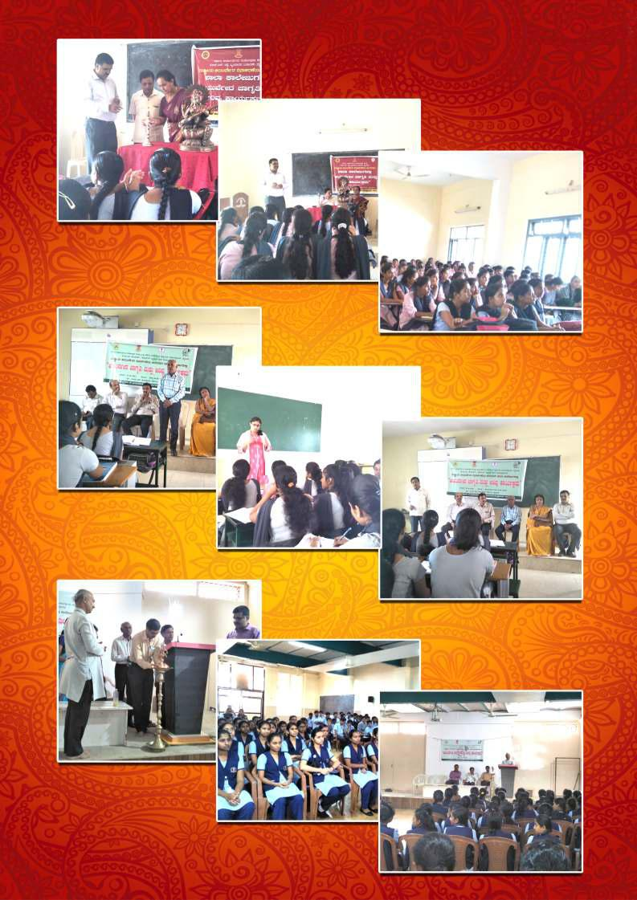

Slide 56
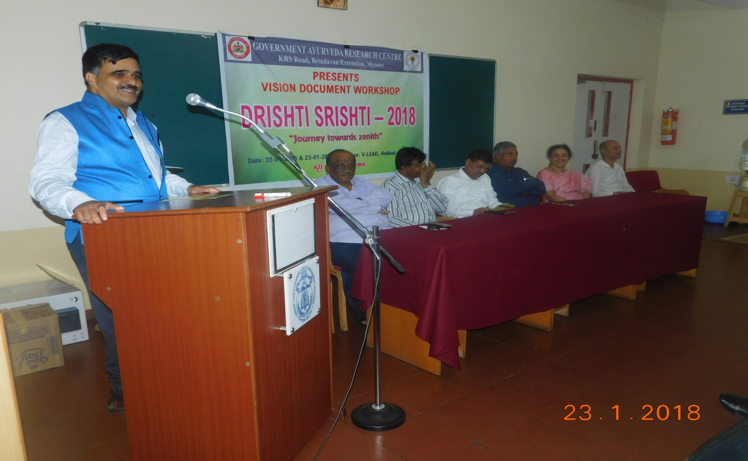

Slide 57
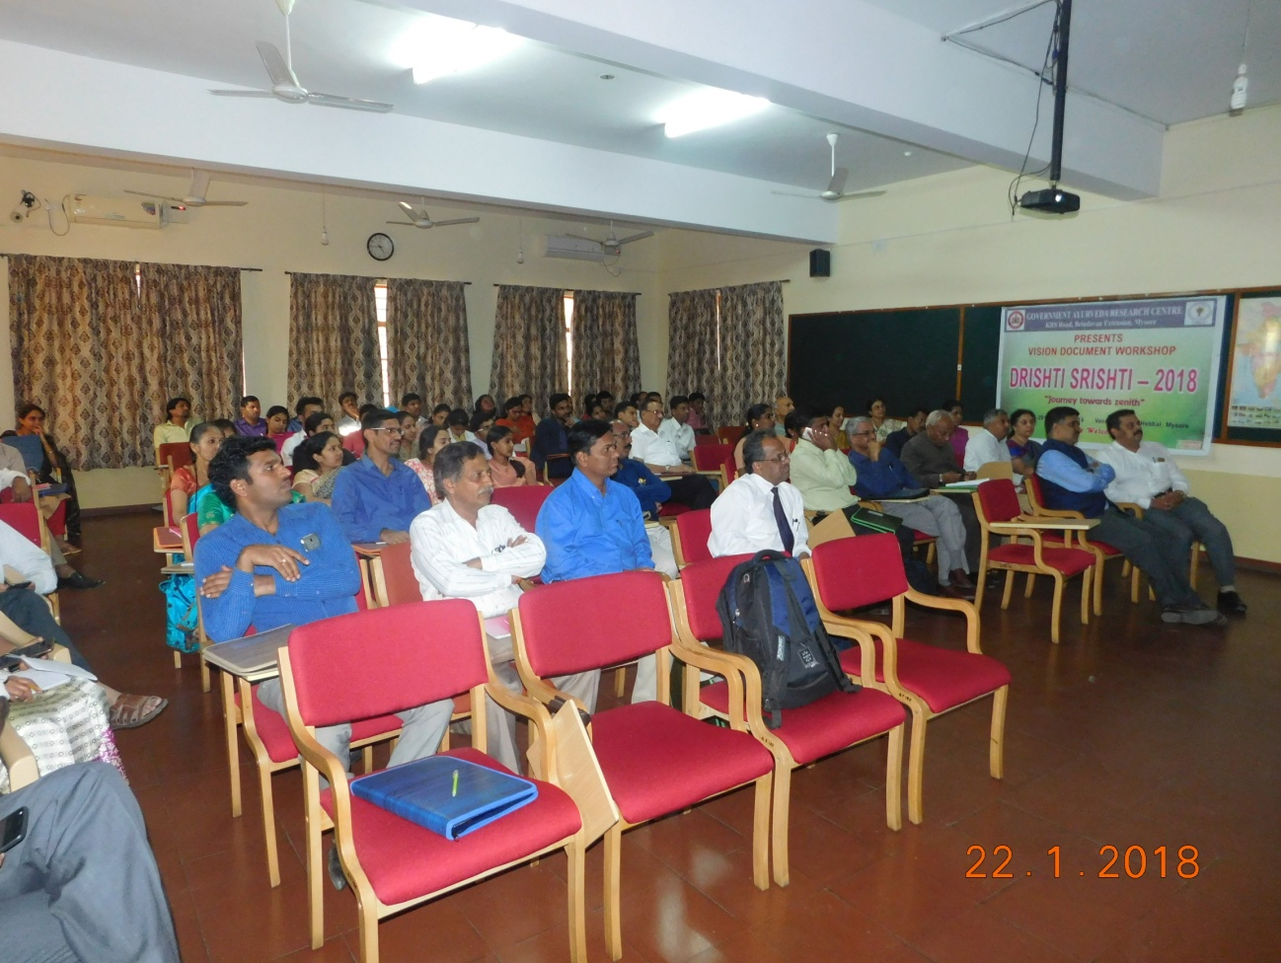

Slide 58
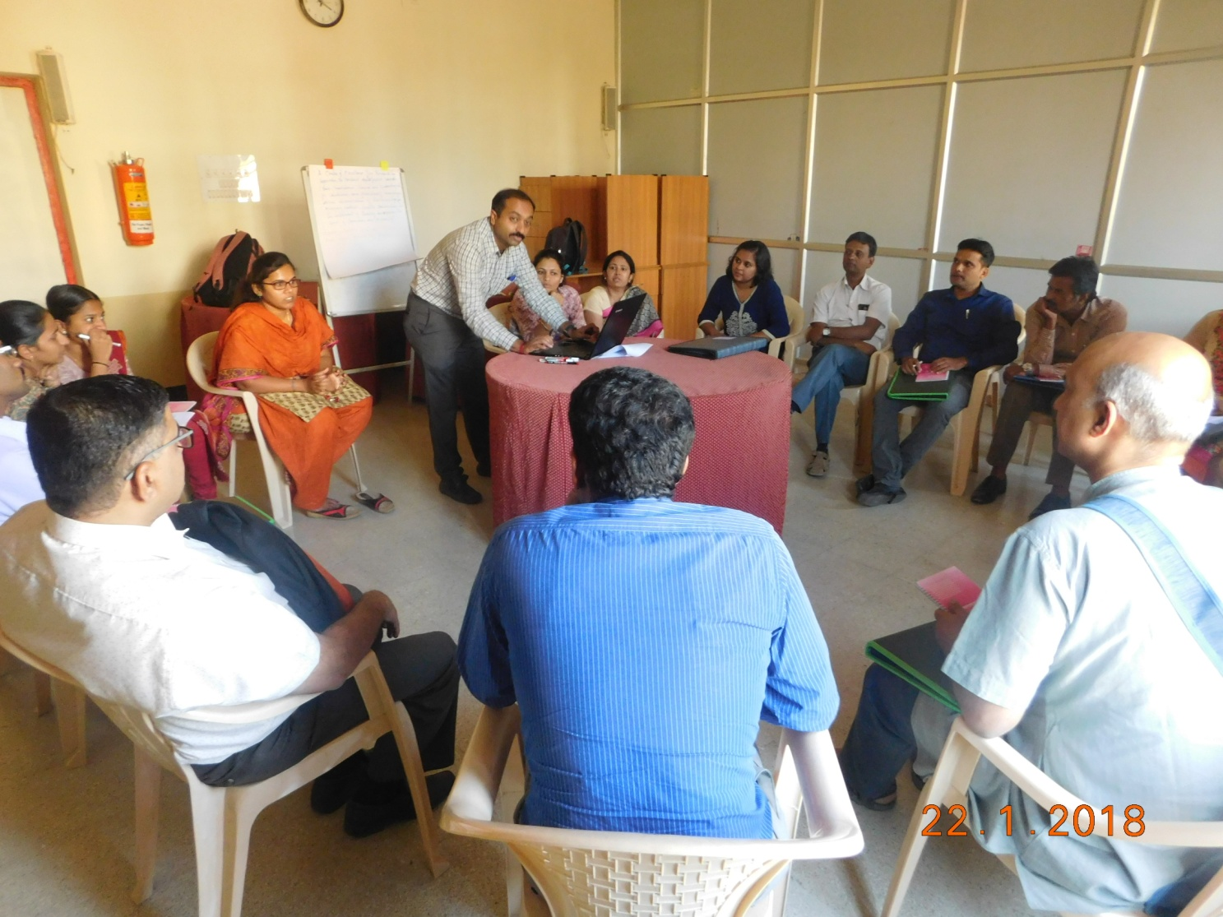

Slide 59
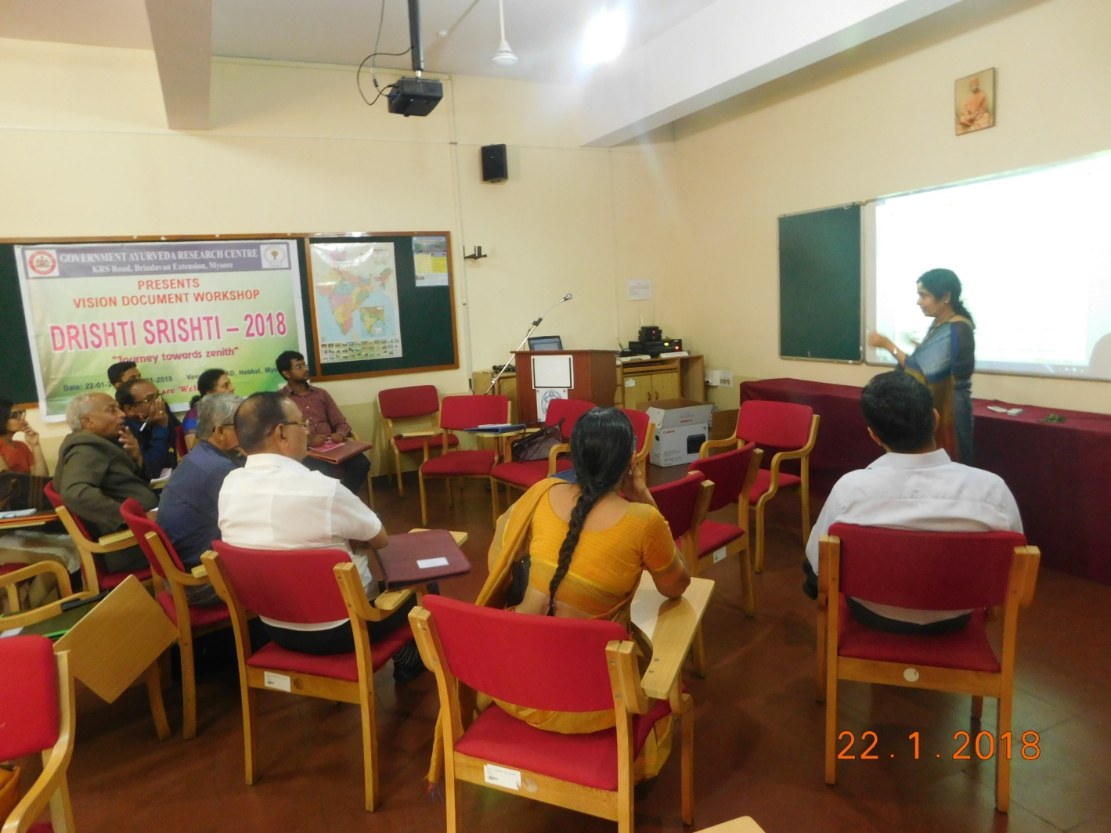

Slide 60
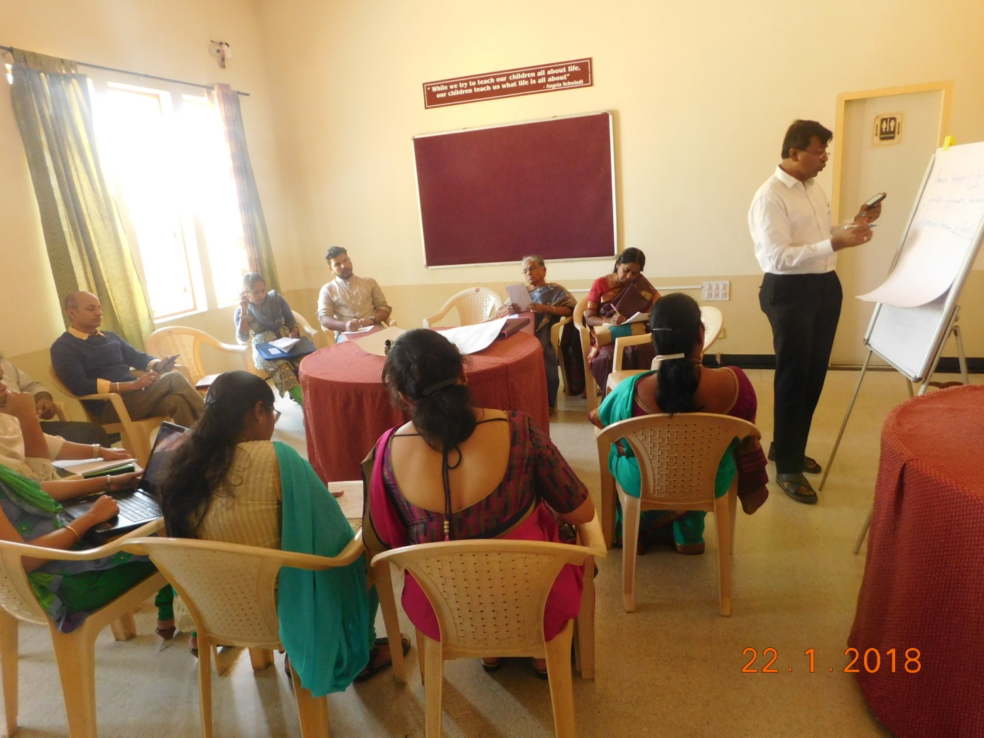

Slide 61
Projects undertaken by research institute
1.Various awareness activity about ayurveda & its impact on the society

Slide 62
RATING SATISIFACTION GIVEN FROM THE PARTICIPATE

Slide 63
TAKE HOME MESSAGE FOR AYURVEDA PROGRAM ON THE BASIS OF QUESTIONER
1.Method of awareness should not be uniform
2.Various method should be incorporated depending upon interest of the receiver.for example:f1.or student quiz,essay are more appropriated than guest lecture.2.for college selfie contest, identification of plants are more apropriate3.for generl public expert talks, health camp, health awareness talks, kitchen remedies, home remedies are more appropriate.
3.To give awareness for the whole population activities like ayur jaatha, ayur nadige, exhibition, open days are more appropriate.

Slide 64
Ints to the stake holder to conduct IEC on ayurveda
1.Awareness programs should not be tailoredment
2.Awareness programme method should be innovative.
3.Method of awareness programme depends on interest of the participate
4.Awareness programme should include participative method of participate & that should be scope for evaluation & it should develop interest in the participate.
5.To enhance interest in participate competitions methodology can be followed.
6.Incentives like prizes will enhance participative spirit & the level of awareness will be doubled

Slide 65
FUTURE PROGRAMME OF AYURVEDA RESEARCH INSTITUTE
1.Development of laboratory, development of inhouse labs of biochemistry,pharmacalogy,behaviour science, botony,pharmacognosy.
2.Survey of medicinal plants & mapping of medicinal plant in kukkaralli lake, chamundi hill, BR hill, Gopalaswamy hill,MM hill.
3.Standarization of treatment protocol
4.Integrated approach for the treatment of tuberculosis in collaboration with WHO.
5. 4.Integrated approach for the treatment of diabetes mellitus in collaboration with Karnataka institute of diabitology.
6.Conducting various seminar, workshop on research methodology, bio-statistics, article writing, publication, patenting, documentation, manuscriptology.

Slide 66
GOD’s PASSWORD

Slide 67
Research password
Any Guess…….?

Slide 68
Idea
Think From Now itself

Slide 69
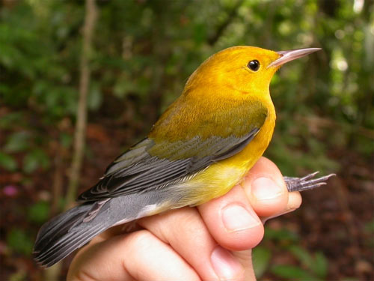
MILES & MILES TO GO BEFORE WE SLEEP
SET YOUR GOAL SKY IS LIMIT FOR YOU
Thank you
Thank you
Thank you

