Slide 1
Concept of study of design & methodologies
DR.LAKSHMINARAYANA SHENOY
ASSISTANT DIRECTOR
AYURVEDA RESEARCH CENTRE
MYSURU

Slide 2
Essentials for project
OUTCOME
QUANTITY
QUALITY

Slide 3
STEPS OF DOING A RESEARCH PROJECT

Slide 4
All progress is born of inquiry
SELECTING A RESEARCH QUESTION

Slide 5
Choose / earmark your area
Know your boundaries
Avoid overlapping
Keep realistic goals
Avoid subject which is overdone
Contraversial subject should not become choice of average researcher
Avoid too narrow or too vague problems
Subject selected for research should be familiar and feasible

Slide 6
RESEARCH DESIGN
Conceptual study
Samhita and siddhanta
Experimental study
Dravya guna and Rasa shastra
clinical trial
Clinical subjects
Observational study
Survey study
swasthavruta
swasthavruta

Slide 7
Knowing the meanings and definitions of technical terms is very important in deciding your study design

Slide 8
DEVELOPING A RESEARCH PLAN
1.SAMPLE SIZE
7.PILOT STUDY
6.COST INVOLVED
5.ASSISTANCE/ GUIDENCE
4.ASSOCIATIONS / COLLABERATIONS
3.TIME FRAME
2.SOURCE OF DATA

Slide 9
DATA COLLECTION
Primary data
Secondary data
Collected afresh and first time through observations, interviews, questionnaire and reports
Data that are already available
Reliability / Suitability/ Adequacy

Slide 10
PROCESSING AND ANALYSIS OF DATA
Usage of statistical methods
Testing the Hypothesis
Interpretation of data

Slide 11
Study Design
How do we set up the study to answer the scientific question(s)?
Two Main categories:
Interventional designs:
The experimenter has control exposure, treatments
Randomized Clinical trials
Observational Studies:
Cohort studies
Case-Control studies

Slide 12
Importance of sample size
Planning of clinical trail
Ensure good prospect of detecting the effects of clinical or scientific interest
Small sample size – beta error (False – ve conclusion)
No enough power to detect true difference

Slide 13
Hypothesis
“Null” Hypothesis
The “it didn’t work” distribution
“There is no association”
“The means are the same”
“There is no difference”
We generally try to disprove the null

Slide 14
Summary: Successful
Research Design and Methods
Bright idea
Well developed and clearly described methods
Appropriate data analysis
Large enough sample size
Plenty of time to do the work
Only minor limitations
Clear pathway to strong conclusions

Slide 15
Designs of the study
1.Clinical study
2.Comparative clinical study
3.Comparative control clinical study
4.Cohort study
5.Factorial study
6.Observation study
7.Longitudinal study
8.Horizontal study.
9.Ethinographic study
10.Case study
11.Single case study

Slide 16
References

Slide 17
Why Reference?
Your benefit
To show off!
To add authority to your argument
To add credibility to your information
Reader’s benefit
To understand the context of your work
To allow your reader to track down your research

Slide 18
Why Reference?
Ethical reasons:
Intellectual integrity
To distinguish between:
  Your ideas
  Someone else’s ideas
Intellectual property issues

Slide 19
What should be referenced?
Is there anything here
you don’t need to reference?
Ideas, information, results, opinions from any source that you have summarised, paraphrased or directly quoted
Definitions of terms
Illustrations, tables, figures drawn from sources
Your ideas that are also those of an author you have read
Plans, ideas or anything that was stimulated by others

Slide 20

Guiding principles
Respect the
  Creation of ideas by others
  Concept of intellectual property
Acknowledge the ideas of others
But,
Don’t reference “common knowledge”

Slide 21
Necessary Information
Names of authors (family names and at least initials)
Name of journal article, chapter or conference paper
Name of journal, book, conference, etc.
Date of publication
Volume number (for journals)
Editor of book (if applicable)
Publisher (for books)
Place of publication (for books)
Page numbers (of article or book chapter )

Slide 22
Basic Referencing Systems: Reference Lists
Numerical (eg. Vancouver)
Sources are listed
  numerically by order of their first citation in the text
  by the family name of the first author
  in other words, each source is given a number that it retains throughout the work.
  Getzen TE. Health economics: fundamentals and flow of funds. New York (NY): John Wiley & Sons; 1997.
  2. Millares M, editor. Applied drug information: strategies for information management. Vancouver,WA: Applied Therapeutics, Inc.; 1998.
  3. Australian Government Publishing Service. Style manual for authors, editors and printers. 5th ed. Canberra: Australian Government Publishing Service; 1994.

Slide 23
A Final Word
Know which system is required
When recording ideas from readings, record all the bibliographic details
Always take note of the page number
Distinguish between information from the source, and your own thinking
Be consistent!
Follow the rules implicitly (don’t question why the system wants a colon and not a comma – just do it!)
Check referencing before submitting

Slide 24
Referencing Help
Websites
UQ Library Citation Guides: http://www.library.uq.edu.au/nott/subject_vr.php?id=CI
UQ Library Referencing Software and Guides, e.g. EndNote, EndNoteWeb, RefWorks on-line library tutorials and library training courses available. Further information on course-relevant websites or contact Library for further.
Citing Electronic Sources: http://www.bedfordstmartins.com/online/citex.html
General Information – APA & MLA styles: http://www.murdoch.edu.au/dirs/citegdes.html
General Information – Harvard and Vancouver Styles: http://lib.monash.edu.au/vl/cite/citecon.htm

Slide 25
Acknowledging sources is called citing or referencing
A citation or reference in the text is where you refer to an author
It may be in the form of a direct quote or a summary or paraphrase of an author
Whenever referring to an author, explain his/her position and your critique/comment on it

Slide 26


HOW does one reference accurately
Many conventions
Vary – university, country, even school and subject area
Much variety here at UQ

Slide 27
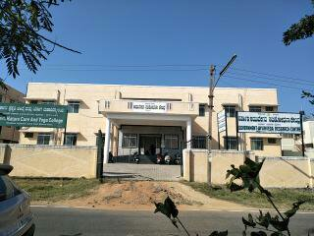
AYURVEDA RESEARCH CENTER
FUTURE IS IN YOUR HANDS

Slide 28
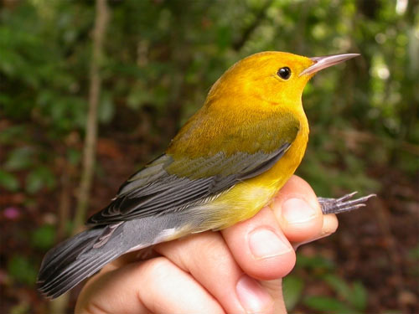
MILES & MILES TO GO BEFORE WE SLEEP
SET YOUR GOAL SKY IS LIMIT FOR YOU
Thank you
Thank you
Thank you

