Slide 1
IMPORTANCE OF YOGA IN DAY TO DAY LIFE
DR. L.N. SHENOY
B.A.M.S. T.C.E.M. MD. (KC)
STATE PROGRAMME OFFICER,
NATIONAL RURAL HEALTH MISSION,
BANGALORE.

Slide 2
YOGA

Slide 3
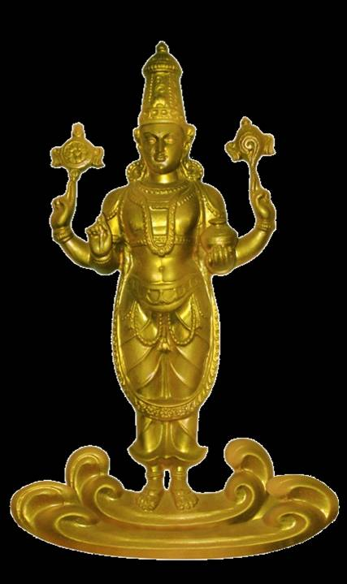


Slide 4


Slide 5
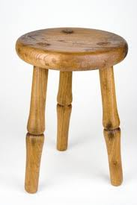
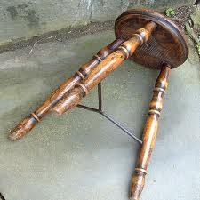
SUCCESS……..!
FAILURE ………?
HEALTH
HAPPINESS
WEALTH-WELL BEING
IT DEPENDS ON US

Slide 6
Advantages of YOGA Interventions
Apart from the well known facts that YOGA is;
Easily accessible
User friendly
No side effects
Community participation is possible
Safe over long term use
Low cost.
NO MEDICINES
BEST IN MENTAL DISEASES

Slide 7
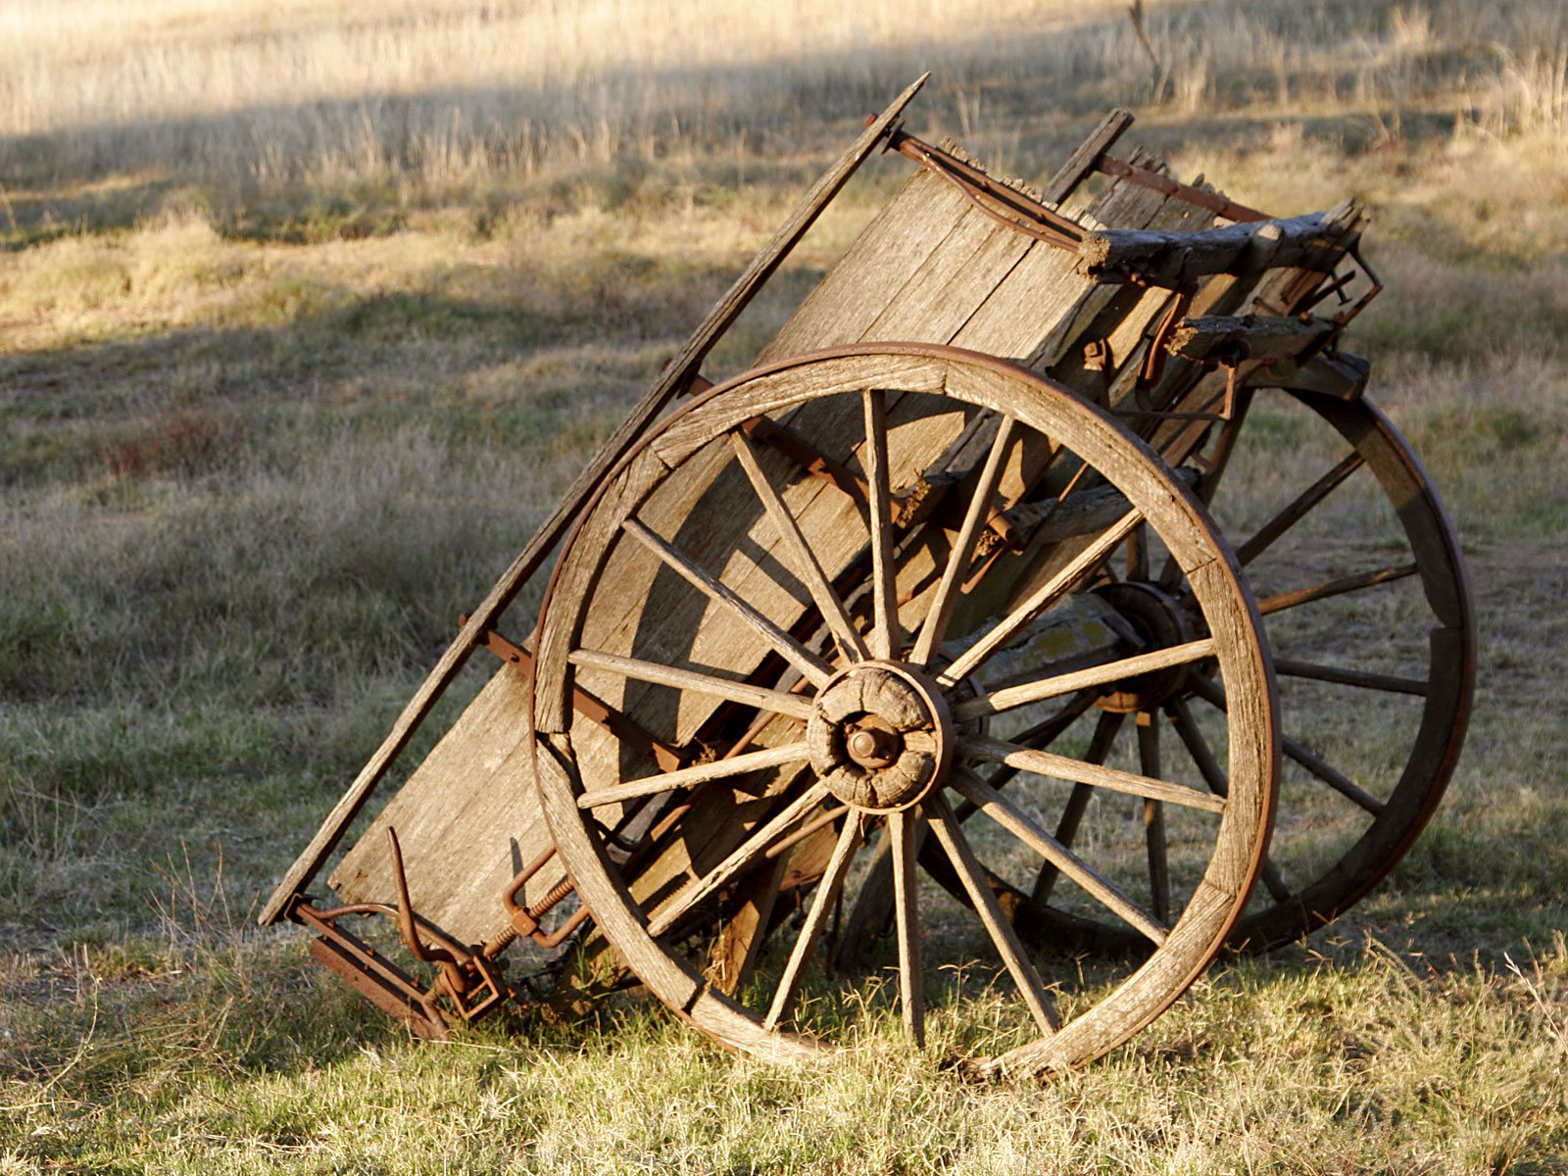
Present scenario
Are you ready for change?

Slide 8
Holistic Classification of Diseases
Iatrogenic diseases - 15%
Chronic illness syndrome - 25%
Emergency diseases - 10%
Minor illness syndrome - 30%
Patient thinks he has a disease syndrome - 10%
Doctor thinks patient has a disease syndrome -10%
Ref:Dr B.M.Hegde Ancient Wisdom Science &Health
Except in Emergency Diseases-10%, in all above 90% of the diseases AYUSH Interventions are useful.

Slide 9
Why YOGA?????
Paralysis –management in acute stage done by conventional system, where as Rehabilitation and long term management is better with AYUSH.
Similarly chronic illness degenerative conditions like Osteoarthritis, low back ache, etc. can be in the long run better managed by AYUSH as evidence proves.
(Planning Commission report 2006. pg no 121)

Slide 10
Why YOGA???????????
The recent reports from UNIDO, showed that about 80% of worlds population today does not have the benefit of modern medicine.
In India more than 70% of India’s population still use AYUSH system of medicine.
Ref: Ashok.D.B.,Vaidya and Thomas P.A.Devasagayam Current Status of Herbal Drugs in India :An Overview Recent Advances in Indian Herbal Drug Research guest editor: Thomas Paul Asir Devasagayam

Slide 11
Why YOGA????
It is difficult to provide comprehensive primary health care to entire population in developing countries like India where 70% of the population lives in rural areas.
One of the most certain and feasible ways to provide to reach the entire world population with education about the importance of basic, preventive and promotive healthcare and how to secure it is to enlist the support and help of traditional medicine and its practitioners in cultures world wide.
Ref:Ghai S, Ghai C M. Health for all by 2000AD:the role of Ayurveda.Nurs J India.1994Jun:85(6):122-4

Slide 12
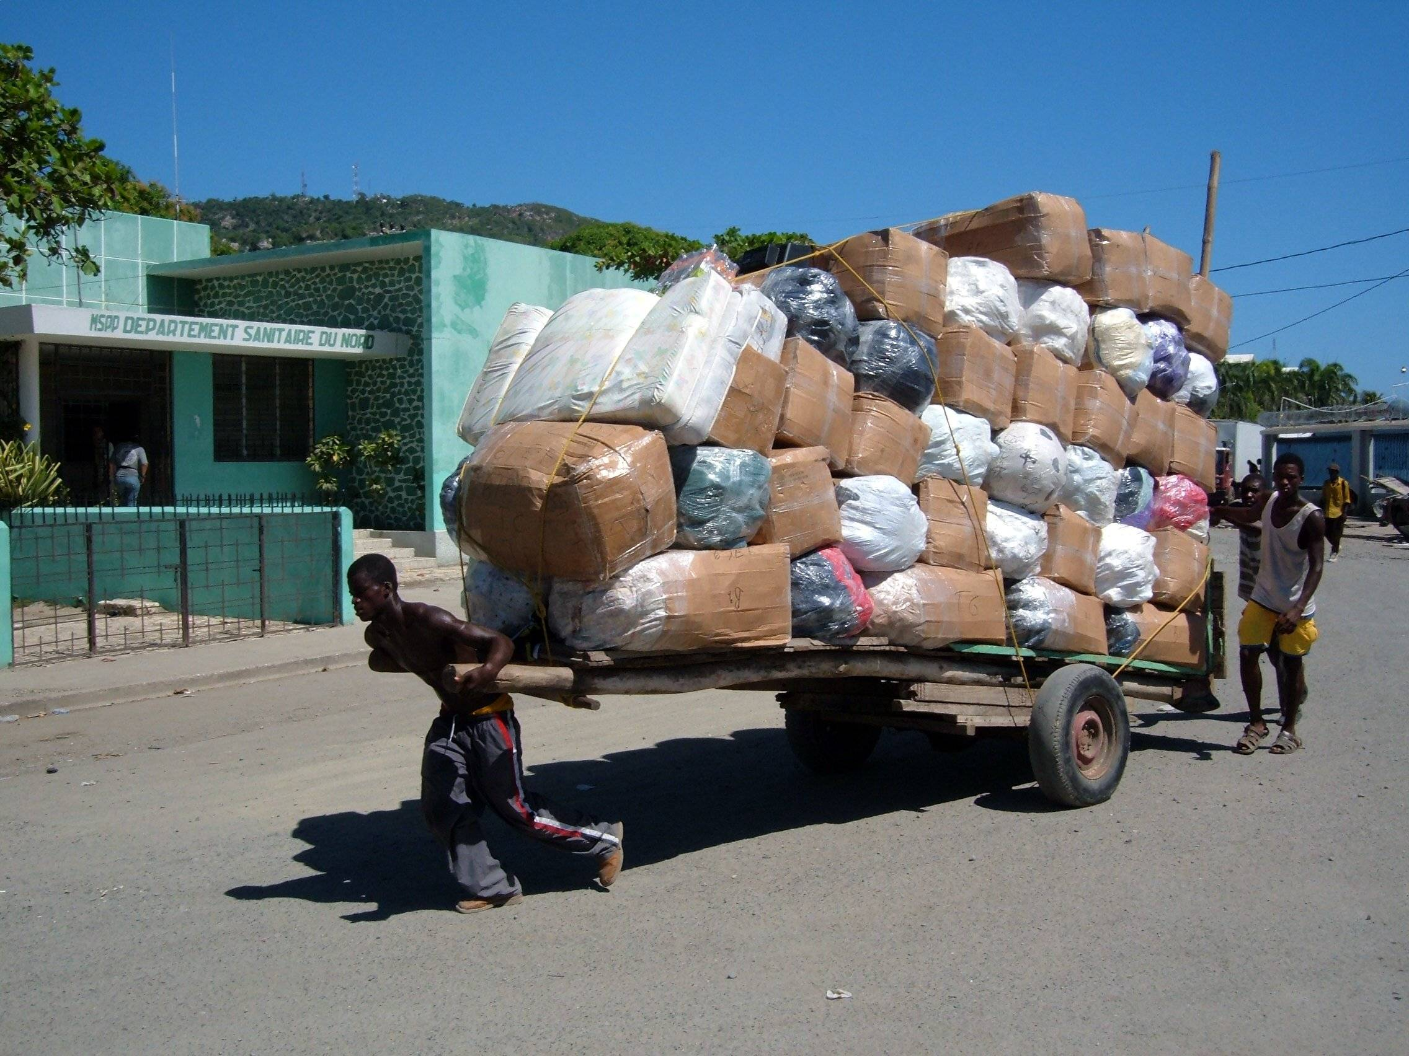
Future scenario
Loads of opportunities are here but no takers. Still you are trying alone without any goals.
Set your goals sky is the limit

Slide 13
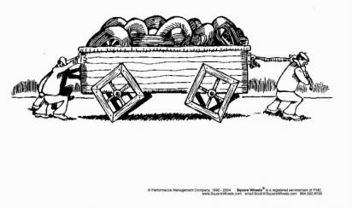

Slide 14
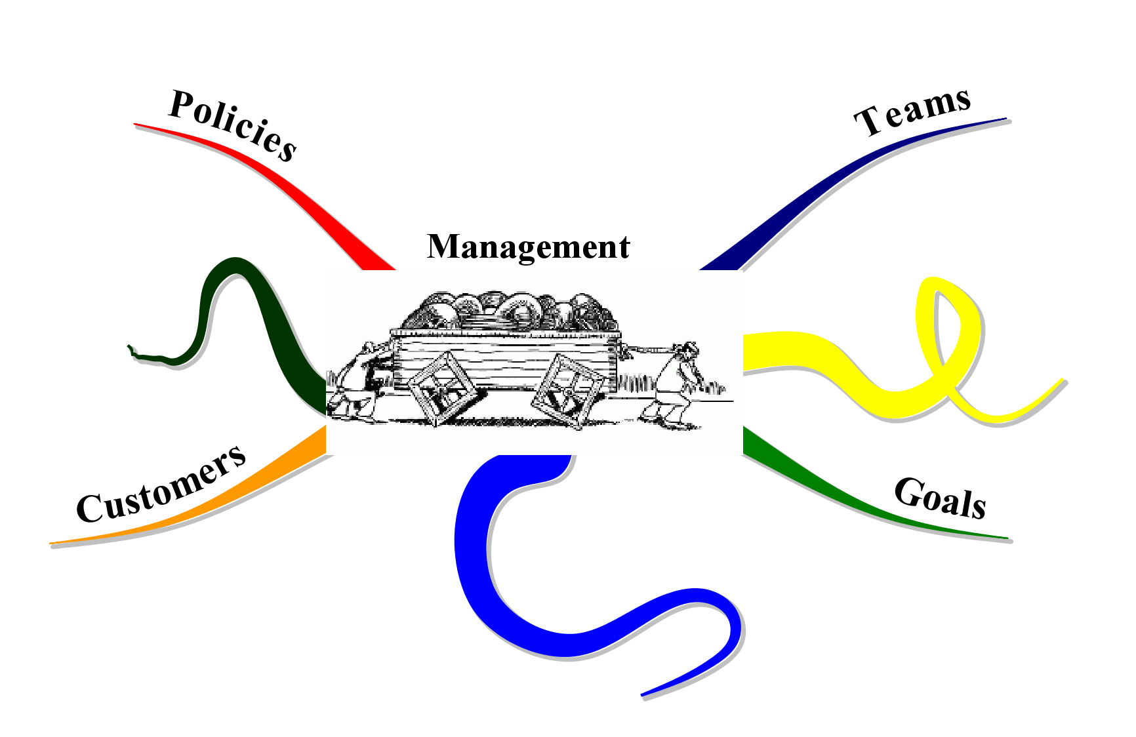

Slide 15
OBJECTIVES OF:
1) To make people self reliant for primary health care
2) To promote AYUSH system of health care at the grass root level.
3) To educate the people about usage of medicinal plants and kitchen items for primary health care
4) To create interest in the health aspects through Home remedies.
5) To make people healthy not only for their family it is also for whole of the society.
6) To Educate and create awareness about lifestyle, food nutrition, hygiene and sanitation etc..
7) To provide primary health care with less/no cost, which is easily and timely available

Slide 16
METHODOLOGY:
Home remedies will be based on:
Lectures from professional Doctors.
Preparations of Home Remedies.
Discussions
Interactive and participatory methods
Group activity.
Identification of locally available medicinal plant.
Reading Material and Handbooks shall be provided
Distribution of saplings for cultivation.

Slide 17
Opportunities Nowhere ???!!!
Opportunities NOW-HERE

Slide 18
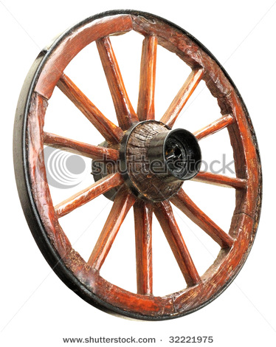



Slide 19
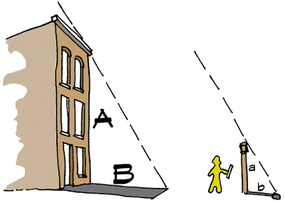
Its not height that matters ,its measurement that matters

Slide 20
Generations changed……
Gallons of water flown in Thames still you are in Sleep
….AWAKE….
It is your time to grab the opportunity.

Slide 21
Why YOGA..?
Everything in the Universe is evolving, even the rocks. If there is metamorphosis in every part of creation, why should not man’s consciousness also undergo this state of metamorphosis ??? Transformation is a scientific fact. It is not a philosophy, faith or creed. Yoga is the path of mind evolution and it gives meaning to life. Through the process of yoga the body is rendered so subtle and pure that it is transformed into a yogic body which is unaffected by old age and disease.
AlÉÑaÉÇiÉÑÇ xÉiÉÉÇ kÉqÉïÇ ¢ÑüixlÉÇ rÉÌS lÉ zÉYrÉiÉå I
xuÉsmÉqÉmrÉlÉÑaÉÇiÉurÉÇ qÉÉaÉïxiÉÉã lÉÉuÉxÉÏSÌiÉ II

Slide 22
Manas
qÉMïüOûxrÉ xÉÑUÉmÉÉlÉÇ qÉkrÉå uÉ×Í¶ÉMü SzÉïlÉqÉç
iÉlqÉÔsÉå aÉëWûmÉÏQûlÉÇ cÉ rÉ²ÉiÉ²É pÉÌuÉzrÉÌiÉ – xÉÑpÉÉÌwÉiÉ

Slide 23
ORIGIN OF YOGA
Mythology – Shiva and Parvati interaction.
PARAMPARA –
Adinatha (Shiva) – Matsyendranatha – Gorakhanatha – Shabara – Bhairava – Pujyapada – Kapali – Bindunatha – Tintini – Bhanuki – Naradeva – Niranjana Maharaj – Krishnamacharya – Yogashree Ranganatha Deshikacharya –

Slide 24
Yoga is one of the 6 darshanas*, authored by Patanjali about whom little is known. Some believe he is the incarnation of the divine serpent ANANTA who supports the whole Universe. Others identify him with Panini the great grammarian who lived in the 2nd century and few identify him as Charakacharya. Some say he was Govinda yogi who initiated Shankaracharya into the science of Yoga.
*6 Darshanas – Nyaya, Vaisheshika, Sankhya, YOGA, Purva and Uttara Meemamsa.
rÉÉåaÉålÉ ÍcÉ¨ÉxrÉ mÉSålÉ uÉÉcÉÉqÉç qÉsÉÇ zÉUÏUxrÉiÉÑ uÉæ±MåülÉ
rÉÉåmÉÉMüUÉå¨ÉÇ mÉëuÉUÇ qÉÑlÉÏlÉÉqÉç mÉiÉÇeÉsÉÏÇ mÉëÉÇeÉÍsÉUÉlÉiÉÉåÅÎxqÉlÉç

Slide 25
Patanjali presented his work in the form of SUTRAs. Sutra is defined as that style which has few words, yet is free from ambiguity, full of essence, Universal in context and affirmative. Words of the sutra, put together, do never ever form a complete sentence, but offer enough for the true teacher to develop the message. The sutra links the teacher and teaching, but by itself cannot explain every point. Its style condenses the message to a terseness that cannot be corrupted, yet it can be learned by heart so that no part is lost. In fact the first step in receiving instruction is to learn the sutras by heart, the teacher trains the aspirant to recite the sutras (remember that oral instruction prevailed at that time) only after the student is thorough with the sutras the teacher begins to expand the meaning. (196 sutras)

Slide 26
To be HERE and NOW is YOGA.
Past …………………………….. X X X
Present…………………….
Future…………………………. X X X

Slide 27
YOGA Nirukti
The word Yoga is derived from the root word ‘YUJ’ which means UNION.
It is an art and science of living which teaches mankind self-evaluation and gives them clues on how to lead a disease free life.
mÉëirÉWÇû mÉëirÉuÉã¤ÉåiÉ lÉUÈ cÉËUiÉqÉÉiqÉlÉÈ I
ÌMülÉç WûqÉå mÉzÉÑÍpÉxiÉÑsrÉÇ ÌMülÉç WÒû xÉimÉÑÂzÉæËUÌiÉ II

Slide 28
Patanjali defines Yoga: “Yoga is the ability to direct the mind exclusively towards an object and sustain that direction without any distraction”.
Attainment of a stable mind in a healthy body is the goal in Patanjali’s Yoga.
Yoga is the union of ATMA with the PARAMATMA.
Yoga is the union of consciousness with the supra-consciousness.

Slide 29
xÉqÉiuÉÇ rÉÉåaÉqÉÑcrÉiÉå – aÉÏiÉÉ 2/48
Yoga is equanimity in success and failure.
rÉÉåaÉÈ MüqÉïxÉÑ MüÉæzÉsÉqÉç - aÉÏiÉÉ 2/50
Yoga is skill and efficiency in action.
rÉÉåaÉÈ xÉqÉÉÍkÉÈ - aÉÏiÉÉ 6/3
Yoga is serenity.
rÉÉåaÉÉå pÉuÉÌiÉ SÒÈZÉ WûÉ - aÉÏiÉÉ 6/17
Yoga is the destroyer of pain.
rÉÉåaÉÈ ÍcÉ¨ÉuÉ×Ì¨É ÌlÉUÉåkÉÈ - mÉiÉÇeÉsÉÏ rÉÉåaÉxÉÔ§É ½
Suspension of all modifications of mind is Yoga.

Slide 30
Vyasa Bhashya
For there to be an aim of Union there must be a state of separation first, and in fact such a separation does not exist, even at this very moment you are united with the cosmic consciousness. In fact you are the actual cosmic consciousness, so the aim of yoga is not really to unite you with anything, for you are already united. It is to make you realize your identity with the greater self. So to make you know and tune in with your existing self.

Slide 31
5 activities which disturb the mind
PANCHA VRITTI
Pramana – Right knowledge
Viparyaya – Wrong knowledge
Vikalpa – Imagination –Delusion
Nidra – Sleep
Smruti – Memory

Slide 32
9 CHITTA VIKSHEPAs distractions or interruptions or obstacles to knowledge
Vyadhi – Illness
Styana - dullness or languor
Samshaya – Doubt
Pramada – Carelessness
Aalasya – Lack of foresight – laziness
Avirati – Fatigue – Over Indulgence
Bhranthi Darshana – Delusions
Alabdhabhumikatwa – Lack of perseverance
Anavastitatwa – Unsteadiness, instability of mind.
These interruptions produce one or more of the following symptoms
Dukha-mental discomfort(grief), Dourmanasya-negative thinking, Angamejayatwa-inability to be at ease in difficult body postures, shwasa prashwasa vikshepa-irregular breathing or difficulty in controlling one’s breath.

Slide 33
PANCHA KLESHA
Due to these obstacles or interruptions, the sadhaka suffers from 5 Kleshas -
Avidya – Ignorance
Asmitha – Egoism (confused values)
Raga – Excessive attachment
Dwesha – Aversion
Abhinivesha – Insecurity-fear of death

Slide 34
6 causes which nullify Yoga
Ati ahara – over eating
Prayasa – exertion
Prajalpa – talkativeness
Niyamaagraha – adhering to rules coined by himself and not according to the shastras
Jana sanga – company of common people
Loulya- unsteadiness – weavering mind
AÌiÉ AÉWûÉUÈ mÉërÉÉxÉ¶É mÉëeÉsmÉÉå ÌlÉrÉqÉÉaÉëWûÈ
eÉlÉxÉÇaÉ¶É sÉÉæsrÉÇ cÉ wÉOèûÍpÉÈ rÉÉåaÉÉã ÌuÉlÉzrÉÌiÉ

Slide 35
6 causes which bring success in Yoga
Utsaha – Enthusiasm(positive attitude)
Sahasa – Perseverance-Adventurous
Dhairya – Courage
Tatwajnana – Discrimination
Nischaya – Unshakable faith
Janasanga parityaga – Avoiding company of common people.
EixÉÉWûÉixÉÉWûxÉÉ®ærÉÉïiÉç iÉiuÉ¥ÉÉlÉÉ¶É ÌlÉ¶ÉrÉÉiÉç
eÉlÉxÉÇaÉmÉËUirÉÉaÉÉiÉç wÉOèûÍpÉÈ rÉÉåaÉÉã mÉëÍxÉkrÉÌiÉ

Slide 36
ESSENCE OF YOGA
Neither descriptions, nor theories, nor suppositions, but direct personnel experiences.
Ex –Sweetness of sugar.
ROLE OF GURU
Yoga must be practiced under a qualified, competent GURU

Slide 37
SCIENCE –
Social science – History, Civics, Geography
Life science – Botany, Zoology….
Law science – Criminal, Civil….
Mathematical science – Arith, Alg, Geometry…
Yoga-4 paths- Rajayoga, Bhakti yoga, Karma yoga and Gyana yoga.
Yoga-8 limbs- Astanga Yoga – Yama, Niyama, Asana, Pranayama, Prathyahara, Dharana, Dhyana and Samadhi.

Slide 38
Present forms of Yoga
Disco Yoga
Kids Yoga
Beach Yoga
Floating Yoga
Power Yoga
Yogerobics
Artistic Yoga
Colour Yoga
Light Yoga
The most recent addition – DOGA.

Slide 39
Raja Yoga says first control the mind and then purify the body. Hatha Yoga says first purify the body through Shat kriyas, Asana and Pranayama, by this the mind becomes stable and its outward going tendencies can be controlled. Yamas and Niyamas will automatically happen.
AzÉåwÉiÉÉmÉiÉmiÉÉlÉÉÇ xÉqÉÉ´ÉrÉqÉPûÉå WûPûÈ
AzÉåwÉrÉÉãaÉrÉÑ£üÉlÉÉqÉÉkÉÉUMüqÉPûÉå WûPûÈ

Slide 40
Yama- Codes of conduct our attitudes towards our environment
Ahimsa
Sathya
Astheya
Aparigraha
Brahmacharya
Forgiviness
Endurance
Compassion
Humility
Moderate diet
Cleanliness
AÌWÇûxÉÉ xÉirÉÇ AxiÉårÉ AmÉËUaÉëWûÈ oÉë¼cÉrÉÉïÌlÉ rÉqÉÉÌlÉ
AÌWÇûxÉÉ xÉirÉÇ AxiÉårÉÇ oÉë¼cÉrÉïÇ ¤ÉqÉÉ kÉëÑÌiÉÈ
SrÉÉeÉïuÉÇ ÍqÉiÉÉWûÉUÈ zÉÉæcÉÇ cÉæuÉ rÉqÉÉ SzÉ

Slide 41
Niyama- Observances
our attitudes towards ourselves
Soucha
Santosha
Tapah
Swadhyaya
Eshwara pranidana
Modesty
Charity
Siddhantavakyashravanam
Japa
Sacrifice
zÉÉæcÉ xÉliÉÉåwÉ iÉmÉÈ xuÉÉkrÉÉrÉ DµÉUmÉëÍhÉkÉÉlÉÉÌlÉ ÌlÉrÉqÉÉÈ
iÉmÉÈ xÉÇiÉÉåwÉ AÉÎxiÉYrÉÇ SÉlÉÇ DµÉUmÉÔeÉlÉqÉç
ÍxÉ®ÉÇiÉuÉÉYrÉ´ÉçuÉhÉÇ ¾ûÏqÉÌiÉ cÉ eÉmÉÉã WÒûiÉqÉç
ÌlÉrÉqÉÉ SzÉ xÉÇmÉëÉå£üÉ rÉÉåaÉzÉÉx§ÉçÌuÉzÉÉUSæÈ

Slide 42
ASANA
rÉÉuÉÎliÉ eÉÏuÉUÉzÉrÉÈ iÉÉuÉÎliÉ AÉxÉlÉÉÌlÉ
ÎxjÉU xÉÑZÉ AÉxÉÉlÉ
iÉiÉÉã ²l²ÉlÉÍpÉbÉÉiÉÈ
Asanas must have dual qualities of alertness and relaxation. When asana are properly practiced there is alertness without tension and relaxation without dullness. It keeps the mind actively calm as well as calmly active. The aim of asanas is to produce physiological balance in different systems working in the human body. They are specially intended to take particular care of the Spinal column. asanass involve different physical movements before the final posture is assumed.

Slide 43
Pranayama
Prana – the vital breath
Ayama – dimension and not control.
Pranayama is practiced in order to expand the dimensions of Prana. The basic nature of Prana is fluctuation and that of mind is Motion.

Slide 44

THE 3 MAIN NADIS
PINGALA (SURYA) RIGHT NOSTRIL
IDA (CHANDRA) LEFT NOSTRIL
SUSHUMNA

Slide 45
Pranayama
uÉÉMçü ²ÉUå lÉÉaÉÉ ZrÉÉiÉÈ
MÑüqÉïÈ EÎlqÉsÉlÉå xqÉ×iÉÈ
SåuÉS¨ÉÉ iÉå ÌuÉeÉ×ÇpÉhÉÇ
M×üMüUÇ cÉ ¤ÉÑiÉÇ ¥ÉårÉÇ
kÉlÉÇeÉrÉÈ xÉuÉïeÉWûÉÌiÉqÉ×iÉÇ uÉÉÌmÉ xÉuÉïurÉÉÌmÉ kÉlÉÇeÉrÉÈ
PANCHA PRANA
Prana
Apana
Vyana
Udana
Samana
UPA PRANA
Naga
Kurma
Devadatta
Krukara
Dhananjaya

Slide 46
BASIC Pranayama
BIC
INHALE
INHALE
EXHALE
EXHALE
BIC
INHALE
INHALE
EXHALE
EXHALE
BOC
BOC

Slide 47
BIC
INHALE
EXHALE
BIC
INHALE
EXHALE
BOC
BOC

Slide 48
Pranayama
Nadi Shodhana
Kapalabhati
Bhastrika
Sheetali
Sheetkari

Slide 49
Pranayama induces calmness and tranquility. When the flow of Prana in Ida and Pingala nadi is equalized, whole body is nourished with extra oxygen and carbon-di-oxide is efficiently expelled.
QUALITY | IDA | PINGALA
Breath | Left nostril | Right nostril
Temperature | Cold | Hot
Sex | Female | Male
Quality | Mental | Physical
Metal | Silver | Gold
Colour | Blue | Red
Energy | Negative | Positive
Nerves | Parasympathetic | Sympathetic
River | Yamuna | Ganga
Planet | Moon | Sun

Slide 50
Asanas bring about body flexibility, Pranayama brings about control over breath and emotions and Meditation brings calmness of mind and oneness of humanity with cosmic consciousness.
Asanas, Pranayama and Meditation mark a transition from the physical to the psychological well-being of an individual.

Slide 51
MUDRAS
Mudras are specific body/finger positions which channelizes the energy. Mudras can be done while you are seated, lying down, standing or walking, but be sure your body position is symmetrical, centered and relaxed.
The best time to practice Mudra is a few minutes before and after sleep, while you travel in a car, OF COURSE with your driver...!!! Or during breaks at work.

Slide 52
When a Mudra is done with full concentration, affirmation and a state of serenity is maintained, cerebral activity is calmed and regenerated. This promotes memory – ability to recollect and creativity as well.
Mudras have a wondrous effect on the emotional area of our lives. Mood fluctuations, which many people suffer today, can often be largely eliminated within a few days by using Mudras.

Slide 53
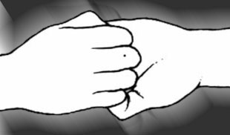
GANESH MUDRA
BENEFITS
Stimulates Heart activity,
Opens up the bronchial tubes,
Gives courage and confidence and
Openness towards other human beings.

Slide 54
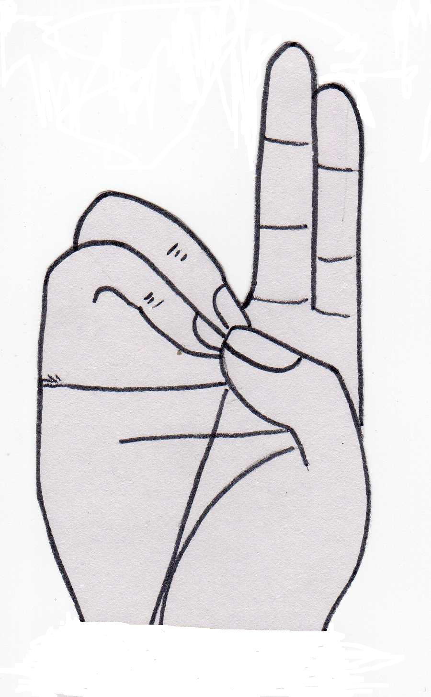
PRANA MUDRA
BENEFITS
Increases vitality,
Reduces fatigue and nervousness,
Improves vision,
Increases assertiveness.

Slide 55

APANA MUDRA
BENEFITS
Detoxifies the body,
Promotes Liver functioning,
Eliminates Uro-genital problems.

Slide 56
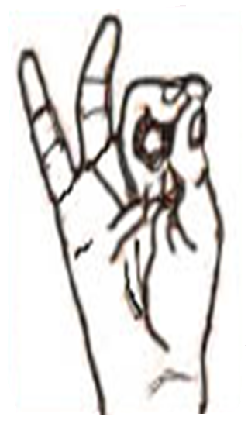
VYANA MUDRA
BENEFITS
Stimulates the Nervous system,
Strengthens the Heart.

Slide 57

UDANA MUDRA
BENEFITS
Increases memory,
Cures Nasal disorders, Stammering,
Bronchial Asthma.

Slide 58
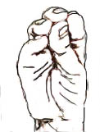
SAMANA MUDRA
BENEFITS
Increases appetite,
Digests food,
Assimilates food,
Segregates the wastes.

Slide 59

MUSTHI MUDRA
BENEFITS
Activates Liver, Stomach, Intestines,
Relieves constipation.

Slide 60
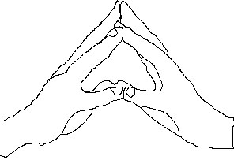
HAKINI MUDRA
BENEFITS
Can be practiced anytime
when you want to remember something,
Promotes co-operation between
the right and left hemispheres of the Brain.

Slide 61
Shat Kriyas
Neti – Jala, Sutra, Dugdha, Ghrita
Dhouti – Antardhouti-vatasara, varisara, vahnisara, bahishkruta
- Dantadhouti-jihwa karna kapala randra chakshu
- Hrud dhouti-vastra dhouti, kunjara kriya
- Mula shodhana
Basti – Jala, Sthala
Nauli – Madhyama, Parshwa(Dakshina & Vama)
Kapalabhati – Vata, Vyuth, Sheeta karma
Trataka – Antar, Bahir

Slide 62
Tri Bandhas
Moola
Uddiyana
Jalandhara

Slide 63

SHAT CHAKRAS
Sahasrara chakra
Ajna – 2 silver grey/clear petalled lotus, 3rd eye.
Vishuddha – Throat, 16 petalled purple lotus.
Anahata – Heart, 12 petalled blue lotus.
Manipura – Navel, 10 petalled yellow lotus.
Swadishthana – Pubis, 6 petalled vermillon lotus.
Muladhara – Perinium, 4 petalled red lotus.

Slide 64
Therapeutic Yoga
Asanas modified to manage Greeva shula
1. Tadasana
2. Mandukasana
3. Parvatasana
4. Simhasana
Asanas modified to manage Kati shula
1. Shavasana
2. Bhujangasana
3. Shashankasana
4. Vajrasana
5. Supta ekapada utthitasana
6. Supta dwipada utthitasana
7. Supta padangushtasana – variations
8. Jatara parivartanasana – variations

Slide 65
Therapeutic Yoga….
Asanas modified to manage Janu shula
1. Tadasana – variations
2. Krounchasana – variations
Asanas modified to manage Vibandha
1. Vajrasana
2. Pavana muktasana
3. Yoga mudra variations
The therapeutic effect of Yoga is only a byproduct and incidental benefit
similar to weight loss in Virechana.

Slide 66
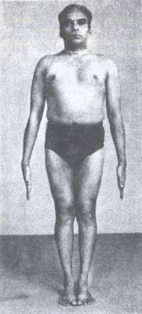
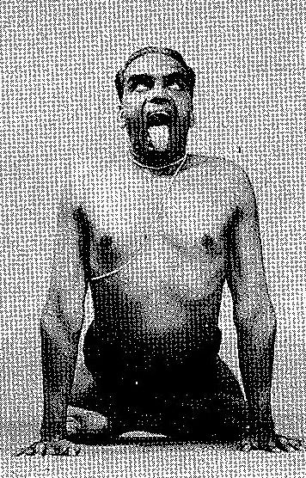
+
NECK LION
Tadasana and Simhasana variation
Notes:
Tadasana and Simhasana variation

Slide 67
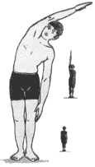
SHOULDER LINE
Variation of
Ardha kati Chakrasana

Slide 68
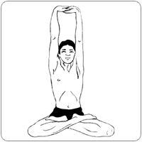
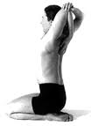
PARVATASANA
MANDUKASANA

Slide 69
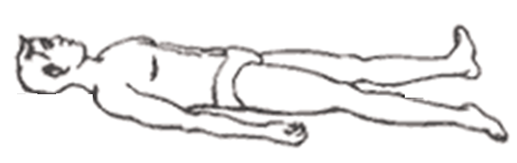
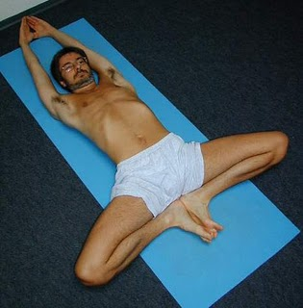
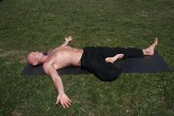
SHAVASANA
SUPTA EKA PADA BHADRASANA
SUPTA DWI PADA
BHADRASANA

Slide 70
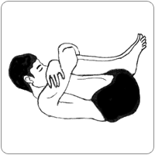
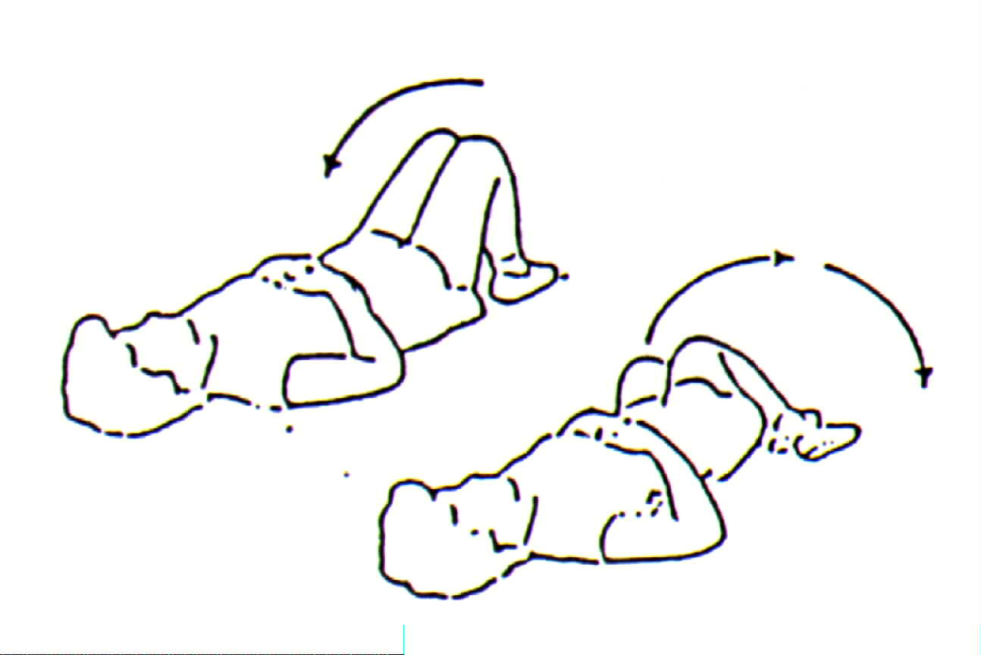
SHAVASANA
PAVANAMUKTASANA
JATARA PARIVARTANASANA

Slide 71
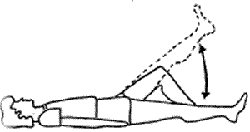
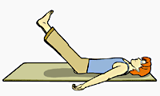
SHAVASANA
SUPTA EKA PADA
UTTITASANA
SUPTA DWI PADA
UTTITASANA

Slide 72
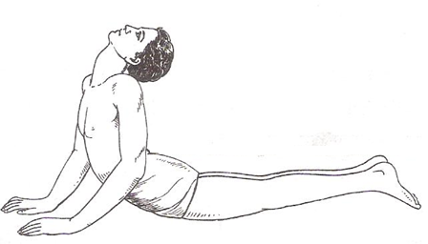
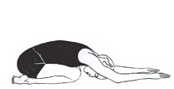
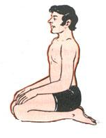
BHUJANGASANA
SHASHANKASANA
VAJRASANA

Slide 73

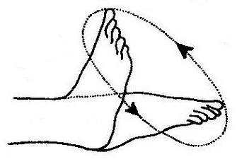
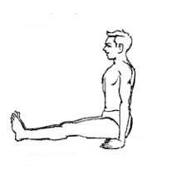
ANKLE ROTATION
CONTRACTED THIGHS
RELAXED THIGHS

Slide 74
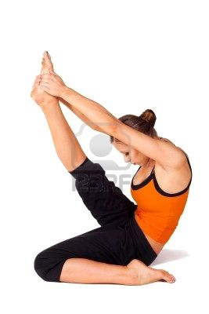
UPAVISHTA UTITA EKA PADASANA
SHAVASANA

Slide 75
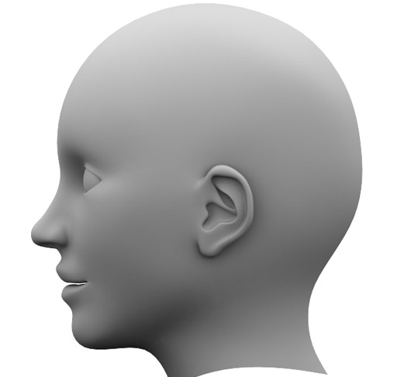

Slide 76
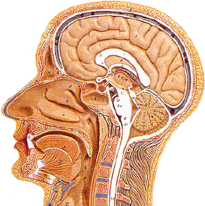

Slide 77
PANCHA KOSHA
MANOMAYA KOSHA
PRANAMAYA KOSHA
VIJNANAMAYA KOSHA
ANANDAMAYA KOSHA
ANNAMAYA KOSHA
Taittireya Upanishad
77

Slide 78

YOGA FOR HELATH YOGA FOR WELTH YOGA FOR HAPPINES
LOKA SAMSTHA SUKHINO BHAVANTHU

Slide 79
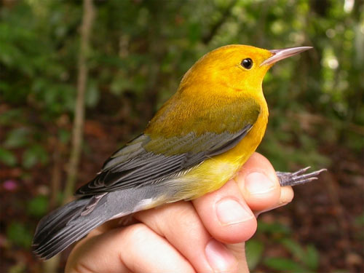
MILES & MILES TO GO BEFORE WE SLEEP
SET YOUR GOAL SKY IS LIMIT FOR YOU
Thank you
Thank you
Thank you

