Slide 1
Welcome to students of Sharada ayurveda college, Mangalore

Slide 2
Career Opportunities in Ayurveda for Upcoming Graduates
Dr. L. N. Shenoy
ASSISTANT DIRECTOR AYURVEDA RESEARCH CENTER MYSORE

Slide 3
Congratulations
For securing a under graduate seat in a prestigious ayurveda college of karnataka under RGUHS

Slide 4
Opportunities No where ???!!!
Opportunities NOW-HERE

Slide 5
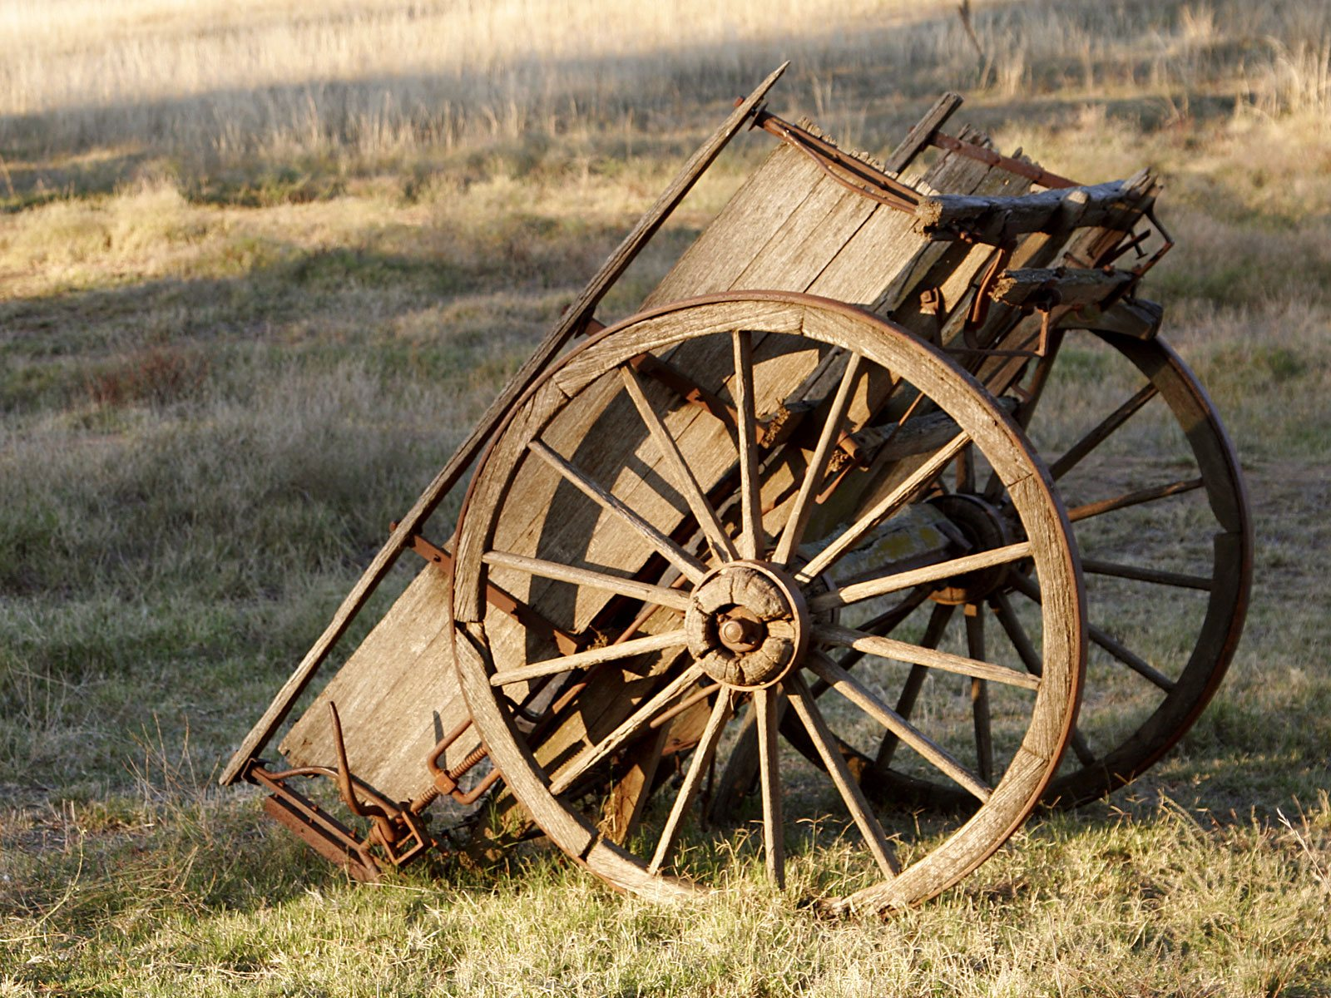
Present scenario
Are you ready for change?

Slide 6
Essentials as students
Knowledge
Technical Skill
Communication Skill
Managerial skill
Attitude
Aptitude
Management

Slide 7
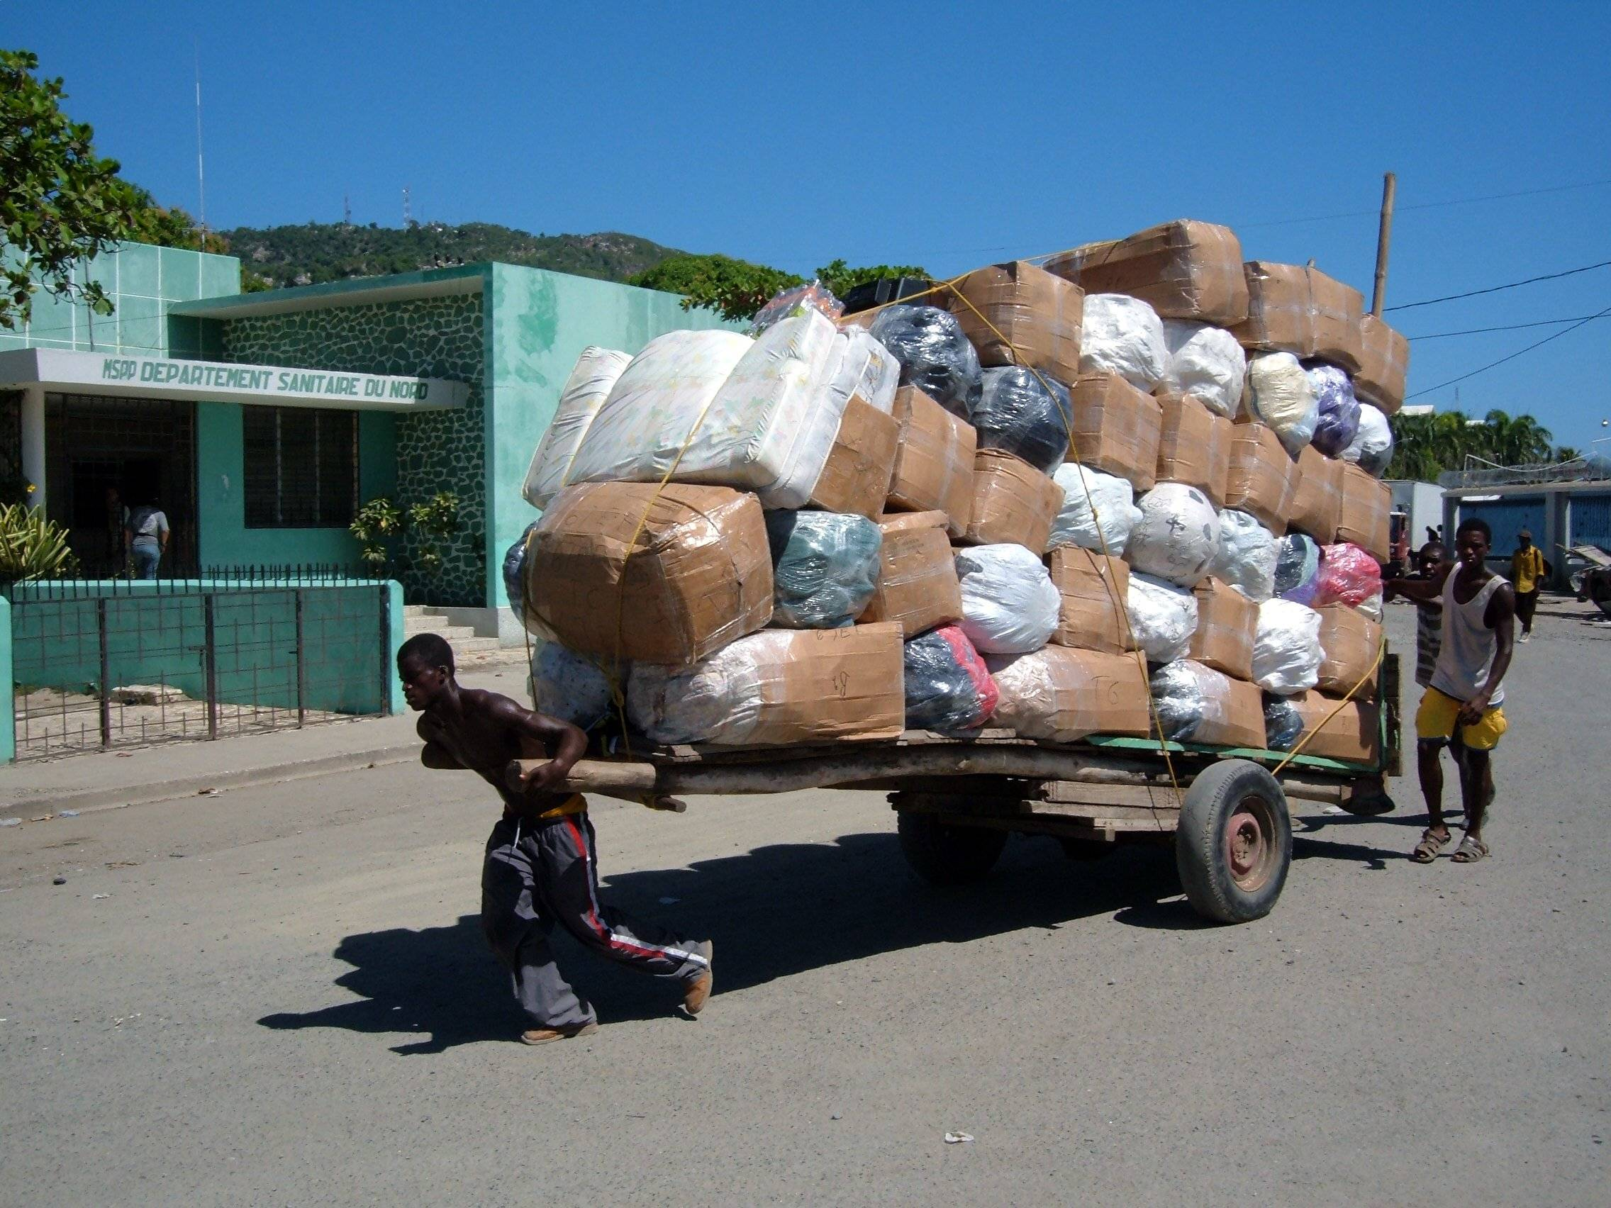
Future scenario
Loads of opportunities are here but no takers. Still you are trying alone without any goals.
Set your goals sky is the limit

Slide 8
Post BAMS
Clinical practice
Further studies PG study fellowship PhD and super specialty
Pharmaceutical opportunities
Government jobs
Other opportunities
Research
Other areas agriculture, biotechnology, forestry

Slide 9
Pre requisites for opportunities
Exposoure of management
Working experience
Post graduate
Under graduate

Slide 10
Opportunities in a nut shell
clinical
pharmaceutical
research
Allied sciences
academic

Slide 11
LADDDER TO SUCCESS sky is the limit!!!!!
Basic qualification
Post graduate degree
Administration skills/practical experience

Slide 12
Ayush health mission a boon or bane???
Man power
District level co located hospital all over india(around 900 district)
Specialty hospitals in districts
Upgradation of taluq hospitals
Integrated ayush hospital of 50 bed each
Giving choice to the patient for choice of their system
Recruitment of additional staff for state HQ

Slide 13
PARADIAGM SHIFT FROM INSTITUTION TO INSURANCE
AYUSHMAN BHARATH

Slide 14
AYUSHMAN BHARATH
It is also called as MODI CARE
It is an revolution in Health Care from Institution based Primary Health Care to Insurance based Health Care and covers all APL / BPL Card holders with in a limit of 5 lakhs Hospital Bill reimbursed by Govt of INDIA.

Slide 15
IMPACT OF AYUSHMAN BHARATH
1.5 lakhs Wellness Center will be opened in the village with at least One Ayush Doctor for center
INDIRECT IMPACT
If a AYUSH Doctor posses a master degree in management / Insurance Administration , he will get an opportunity to be a OFFICER in Insurance Company to look after Health Claims.( Job opportunity >15K )

Slide 16
UNDER NRHM
All allopathic institutions will have one Ayush doctor with in 2017
Vision 2020 says all sub centers will be provided with the Ayush doctor (90,000 sub centers in India)
School health team under RBSK will have 4 doctors per taluk excluding the urban area(already 14,000 ayurveda doctors working under this scheme)
GOI is planning to appoint AYUSH Doctors for Urban centers(10 K Job opportunities)

Slide 17
Under NUHM
All urban centers will be provided with Ayush doctors
National mental health policy emphasized recruitment of Ayush doctors for the post of primary health councilors (more than one lakhs job opportunity)
National health policy 2016 emphasized upon recruitment of Ayush doctors for primary health care delivery services at rural area.

Slide 18
Clinical practice - General
Learn & Train under:
practicing vaidya
Gurukula paddhati
Ayurvedic Hospitals
Dispense
Prepare medicines where ever possible
Equip a simple panchakarma unit

Slide 19
Specialty Practice
Panchakarma :
PG certificate course - MAHE
(www.manipal.edu.com)
Train from any Ayurvedic Hospitals
Cheruthurthy - Kerala
Anorectal :
Train from any practitioner
Course in Kshara sutra (CCIM introducing Diploma course)
Fracture Management :
Triveni Nursing Home - TVPM

Slide 20
Contnd…
periodical training in Panchakarma for practicing physicians at Vaidyarathanam college, Ollur, Kerala.

Slide 21
Contd….
Dentistry : Danta visharada
Jalaram Bappa Ayurveda College - Rajkot
Shalakya : Eye diseases
Sreedhareeyam Eye Hospital and Research Hospital
(www.sreedhareeyam.com)
Oncology : Vaidya Balendu Prakash - Dehradun
e-mail:vcpcrf@sancharnet.in
Beauty aid : Skin care, Hair care etc.
Certificate course in Ayurveda Cosmetics - Pune

Slide 22
Contd….
Preventive Ayurveda : (Promotion of positive Health)
Dietetics:
DM, HTN, Obesity - through Diet & Medicines
Ayurvedic Restaurant
PGDHSc in Applied Nutritionfrom IGNOU/Annamali Uni.
Agadatantra :
Visha Chikitsa Kendra - Kannur (KL)
Traditional Visha vaidyas - Kerala
Bala roga :
Vaidya Gangadharan Nair – Pyannur ,Kerala

Slide 23
Contd….
Pain Management:
Certificate course on Sports Medicine Pune University
PGDHsc in Physiotherapy from Annamalai University
Geriatrics : Applied Ergnomics
PG Diploma in Geriatric care Annamalai university
13. Post graduate integrated course of integrated mental health at NIMHANS , Bangalore

Slide 24
Further Studies
M.D./M.S. (Ay) : through CET
www.rguhs.nic.in - Karnataka
www.bhu.nic.in - Varanasi (UP)
www.ayurveduniversity.com - Jamnagar (GJ)
www.nia.nic.in - Jaipur (RJ)
www.cee-kerala.org - Kerala
www.puneuniversity.com - Pune (MH)
M.D. (Yoga) : www.svyasa.org - Bangalore
M.Sc. (Yoga) : SVYASA and MAHE
M.Sc. In Mental Health and Counseling Kuvempu university
B.Sc and M.Sc YOGA , Annamalai university
6 . Ph.D. : SVYASA and Pune University

Slide 25
Contd….
M.Sc. Medicinal plants - Jamnagar
M.Sc. Anatomy, Physiology, Biochemistry - MAHE
PG Diplomas (Including Distance Education)
PG Diploma in Drug Standardization - BHU (UP)
(www.bhu.nic.in)
PG certificate course in Bioavailability, clinical trials,
Bioequivalence
PG Diploma in Yoga and Nature Cure
Jamnagar, Mysore Universities
YTOT for Doctors
PGDYTD for Doctors SVYASA

Slide 26
Annamalai University
PGDHSc in Public Health
PGDHSc in Hospital Management
PGDHSc in Reproductive and Sexual Medicine
PGDHSc in Medico legal practice
PGDHSc in Adolescent Health and Education
IGNOU
Diploma in Early Childhood care and Education
PG Diploma in Maternal and Child Health
MBA in HR,hospital administration,finance and marketing, insurance management, Event management

Slide 27
Certificate in Rashtriya Ayurved Vidyapeeth (CRAV)
Vd. Ram Harsh Singh, Varanasi - Expert in Kayachikitsa
Vd. Premvati Tiwari, Varanasi :
Expert in Prasuti & Streeroga
Prof. Kulwant Singh, Jammu - Expert in Shalya Shalakya
'Padamshree' Vd. Suresh Chaturvedi, Mumbai :
Expert in Chronic diseases
Vd. Ved Vrat Sharma, Panchkula - Expert in Panchakarma
Vaidya Pt. Amarnath Dogra, Jallandhar :
Expert in Eye treatment
Vd. Mahesh Dutt Shastri, Jabalpur (M.P.) :
Expert in Kayachikitsa

Slide 28
Contd….
Dr. Madhavankutty Varier, Kottakkal (Kerala) :
Expert in Panchakarma
Dr. Krishna Kumar, Coimbatore (T.N.) :
Expert in Panchakarma
Vaidya K.K. Thakral, Lucknow :
Expert in Shalya Shalakya
Dr. N.P.P. Namboothiri, Ernakulam - Expert in Eye treatment
Vd. M. Gangadharan Nair, Trithala, Palakkad Dist. Expert in Balaroga (KL)
Vd. Jagdish Pd. Sharma,Khatu Shyamji, Dist. Sikar :
Expert in chronic diseases
Dr. C. Suresh Kumar, Trivendrum :
Expert in Orthopedic practice

Slide 29
Pharmaceutical companies:
Quality Control / Assurance
Drug Development
Marketing
Government Jobs :
Physicians
District Commissioners
Clinical Research / Medical Transcription
From a reputed institute - 1 year
Can be part of a research project as JRF

Slide 30
Other opportunities:
Massage parlours
Health Resorts
Wellness centers Medical Tourism
Star Hotels
Clubs
Check for the Authenticity of the Center

Slide 31
Post M.D. (Ay) :
Ph.D. - BHU, Jamnagar, Jaipur, RGUHS, Pune,
NIMHANS, SVYASA,
Teaching - All over India
Srilanka, Nepal, Bangladesh
Speciality Practice - Kayachikitsa
Prasoothi
Shalya
Kaumarabhrhtya

Slide 32
Contd….
MRAV : www.ravdelhi.nic.in
Research :
i. Government funded
UGC - Major/Minor research projects
CCRAS / AYUSH
University funding like RGUHS
ii. Private funded
Homibaba fellowship
Tata scholarship / fellowship
Microsoft
Fulbright fellowship

Slide 33
Internationally
UAE
Nepal
Bangladesh recognized by Government
Srilanka
Hungary
Mauritius
Singapore and Malaysia - scope is wide
UK - BSC (honor) in Ayurveda by
Middlesex university – Govt. recognized
Mayur - private

Slide 34
INNOVATIONS
Government of india, Department of AYUSH started a innovative project of Hospital of sports medicine in ayurveda
First hospital started in Trivendram, Kerala 2017
Second hospital started at Mangalore karnataka in 2022
The above centres offer treatment of Marma Chikitsa, Rejuvenative panchakarma techniques

Slide 35
INNOVATIONS IN RESEARCH
A 200 crore multifacility high tech ayurveda research center is established in Kannur, kerala for traditiobnal research at 2016
WHO sponsered global traditional research center is established in jamnagar, Gujarat in 2021
State of art government Ayurveda research center is established in mysore, karnataka at 2017

Slide 36
Hints
CV / resume
Explore yourself
Marks are important
Scholarship
Share each other experiences

Slide 37
MANTRA TO SUCCESS
CV
ADMIISTRATIVE SKILL
COMUNICATION SKILL
MANAGERIAL SKILL
ACADEMIC EXCELLANCE

Slide 38
Prerequisite to Start A Clinic
Degree Certificate
Registration Certificate
KPME Certificate (for Karnataka state)
Biomedical Waste Management
Trade License from Local bodies
Interstate Registration Transfer

Slide 39
Future Opportunities in India
Wellness centers.
Speciality Centers in Multi-National Hospitals. Like FORTIS APOLLO Hospitals etc.,
Start a NGO & give projects to Government of India & get the funds.
Tie up with multi-national drug company for herbal products.
Disease survey & treatment unit.
Disease Speciality hospitals.

Slide 40
7. Super Speciality Panchakarma Centers.
8. Anorectal Clinics.
9. Preventive care therapy centers.
10. Ayurvedic Hotels.
11. Ayurvedic Consumable Industry, like herbal
tea, herbal cigarettes, herbal bidas.
12. All alopathic hospital will have a ayurvedic
units in future.

Slide 41
Central Govt. initiatives
Under co-location
NRHM-all PHC,CHC,TH,DH will have one AYUSH doctor
Panchakarma Ksharasutrs speciality hospitals in Dist HQ
Super speciality Hospitals in NIMHANS,KIDWAI,JAYADEVA,
Speciality hospitals in PPP Mode with sreedhareeyam,vaidyaratum ,etc..

Slide 42
Govt. of Karnataka Initiatives
State of art AYUSH research centers in all divisions
Superspeciality AYUSH hospitals in all divisions
AYUSH hospitals for all TQ,
AYUSH hospitals for all Hobalis,
State of art mega AYUSH pharmaceutical production unit

Slide 43
Under PPP mode
In 12th plan AYUSH outlay is 6.500 crores
NGO’s can establish speciality hospitals,resorts and clinical opd’s
GOK subsidy for resorts under tourist policy
GOK recognizes and reimburses opd and ipd bills of AYUSH centers
GOK efforts to reimbursement facility at insurance sector

Slide 44
ITEGRATED PRACTICE
Efforts are going on to allow AYUSH doctors ethically practice allopathy medicines?

Slide 45
New Initiatives * Model ayush District Programme * Model YOGA Taluk Programme * Prevention of Aneamia through AYUSH * Geriatric carethrough AYUSH * Integrated Research in AYUSH (Specality Hospitals)

Slide 46
Opportunities Nowhere ???!!!
Opportunities NOW-HERE

Slide 47
Futuristic view in Ayush
In agriculture sector identification conservation and cultivation of RET species
Training and development in tissue culture
Exporting cultivated drugs in demand
Govt of india is initiating schemes for national programs for geriatrics(rasayana)
In NCD national programs opportunities for ayush doctors
In 2019 government of india announces to establish a Ganga corridor to develop the RET species along with sides of ganga river

Slide 48
Opportunities in private sector
In all ayurvedic medical stores appointment of qualified ayush doctors
In all super speciality hospitals specilized ayush therapies clinic will be opened
Narayana hridayalaya bangalore is developing a curricullum with certified course for ayush doctors in ICU management
Manasa shivamogga wanted to start a course for ayush doctors for mental ailments

Slide 49
Recent Initiatives from GOI for Ayurveda Doctors
Appointment of AYUSH Doctors in Railway Hospitals, already recruited in 55 centers
Appointment of AYUSH Doctors in Military Hospitals, already recruited in 45 hospitals
Appointment of AYUSH Doctors in Center University Health Centers

Slide 50
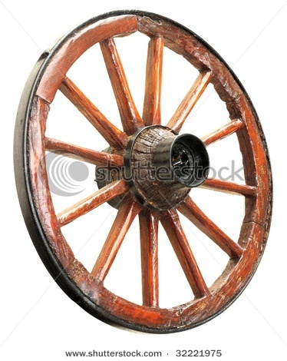
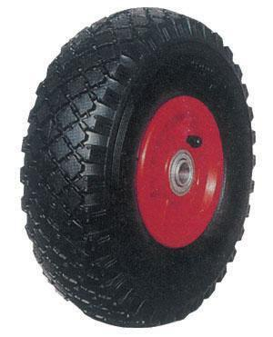
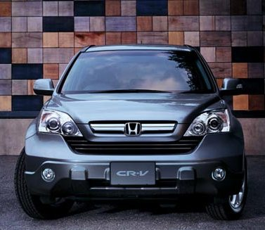

Slide 51
Its not height matters ,its measurement that matters

Slide 52
Generations changed……
Gallons of water flown in Thames still you are in Sleep
….AWAKE….
It is your time to grab the opportunity.

Slide 53
OPPORTUNITIES IN A GLANCE
PHARMACUITICAL
RESEARCH
ACADEMIC
CLINICAL
ALLIED

Slide 54
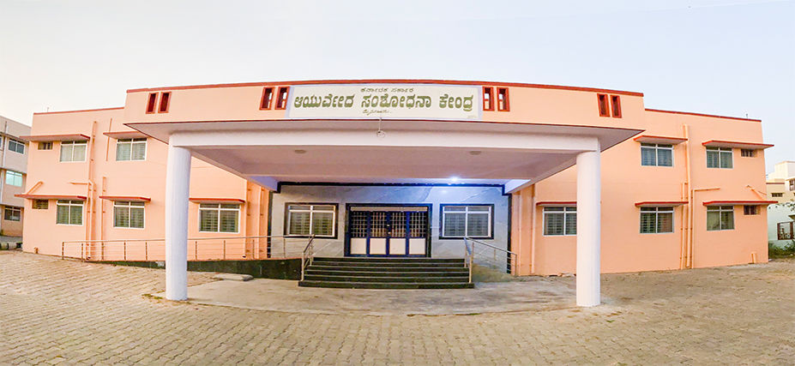
AYURVEDA RESEARCH CENTER
FUTURE IS IN YOUR HANDS

Slide 55
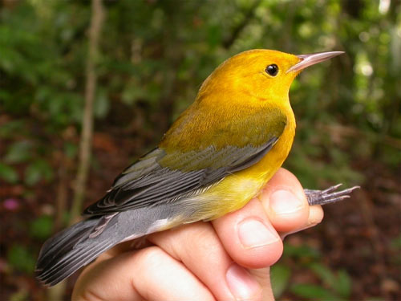
MILES & MILES TO GO BEFORE WE SLEEP
SET YOUR GOAL SKY IS LIMIT FOR YOU
Thank you
Thank you
Thank you

