Slide 1
Time Management for the Successful Student Leader
Sharon Phillips-Pittman
July 25, 2015

Slide 2
Managing Time
There are 168 hours in every week.
How are you spending yours?
Sleeping
Going to the Gym
Getting ready for class
Working on campus
Shopping for groceries
Caring for family members
Going out with friends
Cultivating a relationship
Meeting new people
Going to office hours
Volunteering
Going to class
Studying for tests
Doing library research
Taking a nap
Exercising
Catching up!
Commuting
Getting around campus
Playing an instrument
Trying to unwind
Attending events on campus
Helping a friend
Checking email
Revising your essay
Getting coffee
Chatting with friends
Keeping in touch with family
How does everything get done?

Slide 3
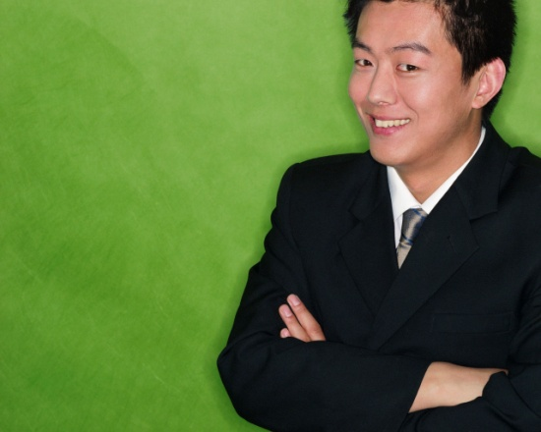



Myths about Time Management
Time management is nothing but common sense. I do well in school, so I must be managing my time effectively.
Time management? I work better under pressure.
No matter what I do, I won’t have enough time!
It takes all the fun out of life!!!

Slide 4
The Reality
As college students, you are very busy people, and to make those 168 hours effective, you have to do some planning.
The Benefits of Time Management
You are more productive.
You reduce your stress.
You improve your self-esteem.
You achieve balance in your life.
You avoid meltdowns.
You feel more confident in your ability to
get things done.
You reach your goals.
What is Time Management?
Simply, making the most of your time and energy!

Slide 5

A Word about ENERGY
The most overlooked aspect of time management is your energy level.
Evaluate your energy level at different times of day.
Schedule tasks when you have the energy level to match.
If you are a “morning person,” seize the early hours
to study and do assignments that require focus.
If you are an “evening person,” make sure that you
are being productive and not sacrificing sleep for extra
hours to socialize.
Losing sleep is the easiest way to sabotage your energy level!
Don’t let this be you!

Slide 6
Steps to Managing Your Time
Set goals
Make a schedule
Revisit and revise your plan

Slide 7
Where to start?
1. Set Goals!
Go for the goal!
Make your goals specific and concrete. Don’t be vague.
Set both long-term goals and short-term ones to support them.
Set a deadline for your goals.
Integrate your goals: school, personal and career.
Realize that goals change, but know which goals to stick to!

Slide 8

Set Goals!
From your goals, set priorities.
1
What’s important and what isn’t?
  Is it Urgent and/or Important
What order do things need to be done in?
Once you know what your priorities are, you need to plan out a schedule for the semester, the week and the day.
Planning may seem hard at first, but the more you do it, the easier and more natural it gets.
2
3

Slide 9
2. Make a Schedule
Set Up Your Semester Calendar
Look at the syllabus for the class schedule.
Begin with blocking all class and lab times.
Block all other set time obligations:
  Work, church, meetings and so on…
Highlight all exams and project due dates.
Identify routine homework days.
Work backwards from exams and papers and map out study/writing time.
Don’t forget to take a break once in a while.
All work and no play will drive you nuts!

Slide 10
Make a Schedule continued
Set Up Your Weekly Plan
Spend 30 minutes or so mapping out the week.
Ask yourself these questions about the week:
  What do I expect to accomplish?
  What will I have to do to reach these goals?
  What tasks are more important than others?
  How much time will each activity take?
  When will I do each activity?
  How flexible do I have to be to allow for unexpected things?
Remember to Expect the Unexpected...

Slide 11
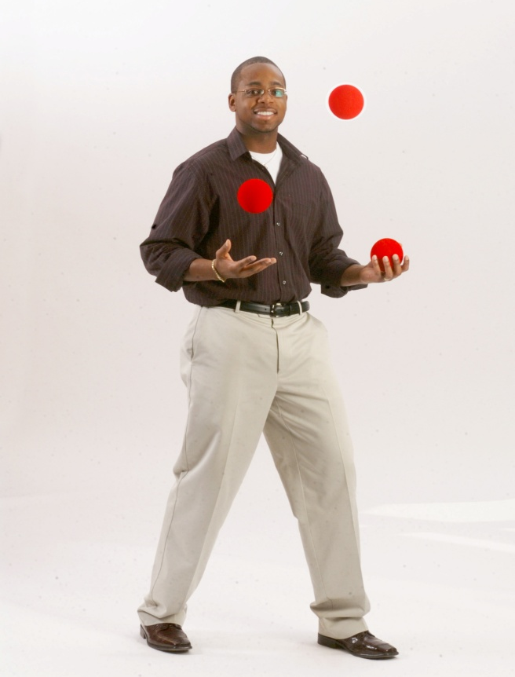
Derek’s Schedule
With everything that I’m juggling, I need to use some major time management skills!

Slide 12
A Week in Derek’s Semester
Monday | Tuesday | Wednesday | Thursday | Friday | Saturday | Sunday
22 Work til 5:00 Biology 5-7pm | 23 Work til 5:00 Finish World Civilization Paper at the Library 6-10pm | 24 Work til 5:00 World Civilization 6-9 pm Paper Due | 25 Work til 5:00 Biology 5-7 pm Lab Due Next Week | 26 Work til 5:00 Mom’s Birthday Party 6:00 pm | 27 Bike Ride 8:30 am Choir 10 am Work on Bio Lab Report 12pm Pick up Keith at the airport 3pm | 28 World Civ Reading 9 am Church 10:30 Barbecue at Ronda’s 1pm Catch up on homework 7-10pm
How effective is Derek’s schedule?
Does he allow enough time to accomplish what he schedules?
Is he paying attention to his energy level?
Does it look like Derek will accomplish everything he plans?
How well will he be able to accomplish certain tasks?

Slide 13
Do you have a schedule?
Organizing Your Day:
“Work smarter, not harder.”- Alan Lakein
Set realistic goals, there are only 24 hours in a day.
Use spare time to review.
Study at the same time each day: make it a habit
Divide study time into 50-minute blocks.
Don’t forget to reward yourself when you do something right!
Take it one day at a time…

Slide 14
Do you use a Daily Planner?
Complete a term assignment preview.
Use a “week at a glance” organizer.
Enter in due dates and social events as soon as you can.
Review your calendar daily for the current week and upcoming week.
It just takes a moment to review your calendar and it relieves stress to know you are on top of things.

Slide 15

Derek’s Scheduled Day
9am-12pm | Work
12pm-1pm | Lunch | Read World Civ. Book
1pm-5pm | Work
5pm-6pm | Head Home | Eat Dinner
6pm-10pm | Library | Work on World Civ. Paper

Slide 16


Derek’s Scheduled Day
ruined
Derek, I might be late getting home from work. We might not eat til later.
Derek, I need your report by 1 pm. It might cut into your lunch hour, but it’s a top priority.

Slide 17


Derek’s Scheduled Day
SAVED
Okay, I’ll plan to be home at 6:00.
If I have to work through lunch can I leave early? I have an important class assignment that I need to work on.
That should be alright.
If I feel tired at the library, I’ll just take a walk.

Slide 18
Derek’s Scheduled Day
revisED
^
9am-4pm | Work
4-5:30pm | Study | Read World Civ. Book
5:30-6:30pm | Head Home | Eat Dinner
6:30-8pm | Library | World Civ. Paper
8-8:30pm | Walk | Call Jasmine
8:30-10pm | Library | Finish Paper

Slide 19
3. Revisit and Revise Your Plan
Are you making progress?
Now that you’ve been paying attention to your schedule, how are you actually using your time?
Which tasks were you able to do? What didn’t get done?
Was your energy level appropriate? Your stress level?
What changes need to be made to your weekly schedule?
What are persistent time wasters?
Could better communication have helped you stick to your plan?
Was procrastination an issue?
Be tough with your time!

Slide 20
Procrastination:
“Never do today what you can put off ‘till tomorrow!”
Forms of procrastination:
Ignoring the task, hoping it will go away
Underestimating how long it will take
Overestimating your abilities and resources
Telling yourself that poor performance is okay
Doing something else that isn’t very important
Believing that repeated “minor” delays won’t hurt you
Talking about a hard job rather than doing it
Putting all your work on only one part of the task
Becoming paralyzed when having to make choices

Slide 21
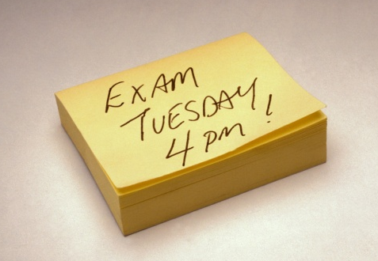
How to Overcome Procrastination
Win the mental battle by committing to being on time.
Set and keep deadlines.
Organize, schedule & plan.
Divide a big job into smaller ones.
Find a way to make a game of your work or make it fun.
Reward yourself when you’re done.
Tell your friends and room mates to remind you of
priorities and deadlines.
Learn to say “no” to time wasters.
Use lots
of
Stickies

Slide 22

Tackle Time Wasters
First, learn to recognize when you’re wasting time.
Decide what you need to do and can realistically do.
Learn how to say “NO” when you don’t have time.
Use an answering machine and return calls at your convenience. The telephone is a major time killer.
Learn to say “I can’t talk right now. I’ll get back to you.”
Wasting time is often linked to a lack of self-discipline.
Ask yourself, “Do I really need to do this or not?”

Slide 23

Learn to say “No!”
Don’t let distractions sap your time!
Avoid the temptation to socialize when you’ve scheduled work.
If friends ask you to join them last minute, decline outright, but ask if you could get together later in the week.
Socializing is important when you don’t have other things to worry about!
Study somewhere you won’t be tempted to chat, watch movies or YouTube, or use social utilities like Facebook.
I have a study group tonight. Are you free on Thursday?

Slide 24
Revisit Your Values
Knowing what is most valuable to you gives direction to your life.
Your energy should be oriented first toward things that reflect the values that are most important.
Examine your values to help you make time management decisions.
Time is a very valuable resource.

Slide 25
Time Management Techniques
The Set Time Method
  Block out a specific time to accomplish a task.
  Examples:
    Monday 1:00—2:00 Work physics problems
    Saturday 9:00—11:30 Go to the gym
The Swiss Cheese Approach
Whenever you find yourself with some free time, do a small part of a larger task
      Examples:
    Arrive to class 10 minutes early and brainstorm research ideas while waiting for your friend to arrive for lunch, review notes from today’s History lecture.

Slide 26
REVISE and PREVIEW:
Staying on top of things…
Immediately note all changes.
Exam/Paper due date revisions
Meeting additions/cancellations
Work schedule changes
Upcoming visitors, etc., etc…
Preview the upcoming week making any necessary adjustments.
Preview each day to see what might happen…
Be Prepared!

Slide 27

If you commute to school, you can…
Listen to audio lectures or podcasts.
Go over what you learned in class on your way to or from work.
If you carpool with others from your class, use the time to discuss class material.
Exchange phone numbers with other students early in the semester.
Create a personal commuter telephone directory.

Slide 28
Review
Time and energy management can make you more productive and reduce your stress level.
The Three Steps
  Set goals
  Make a schedule
  Revisit and revise your plan
Be tough with your time. Actively avoid procrastination and time wasters. Learn to say “no” to distractions.
Employ a variety of time management strategies to maximize your time.
Relax and enjoy the extra time that you’ve discovered!

Slide 29
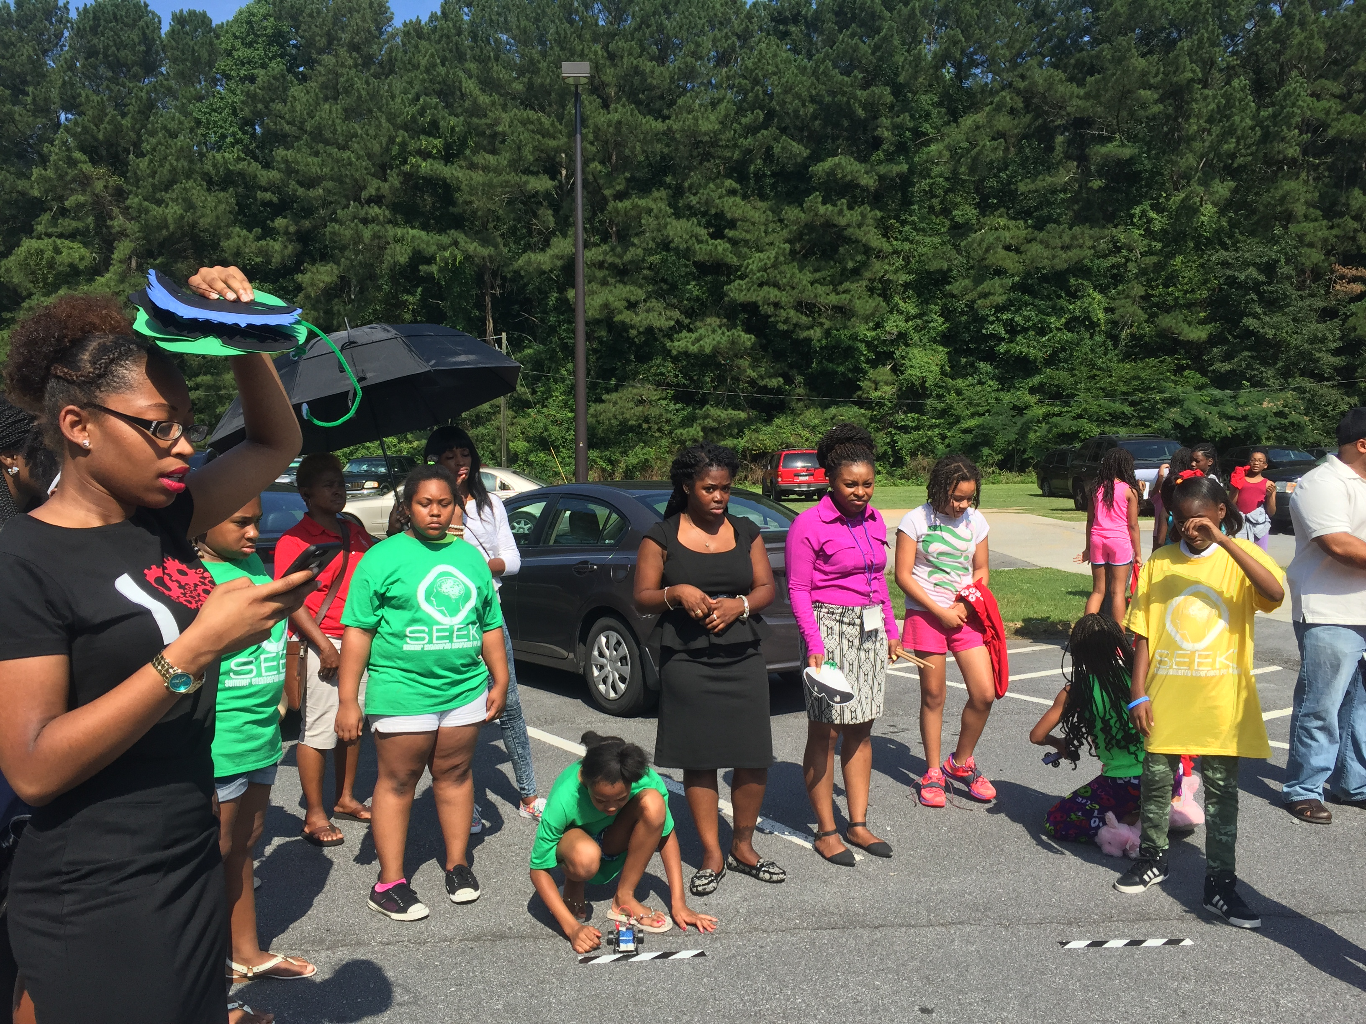


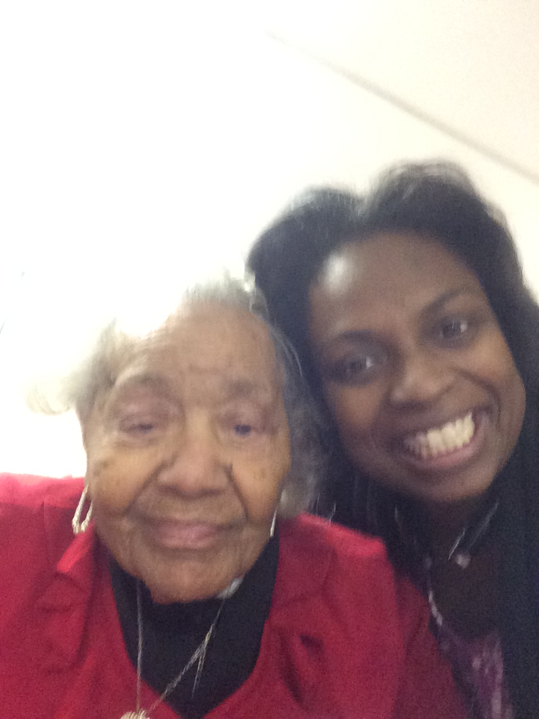
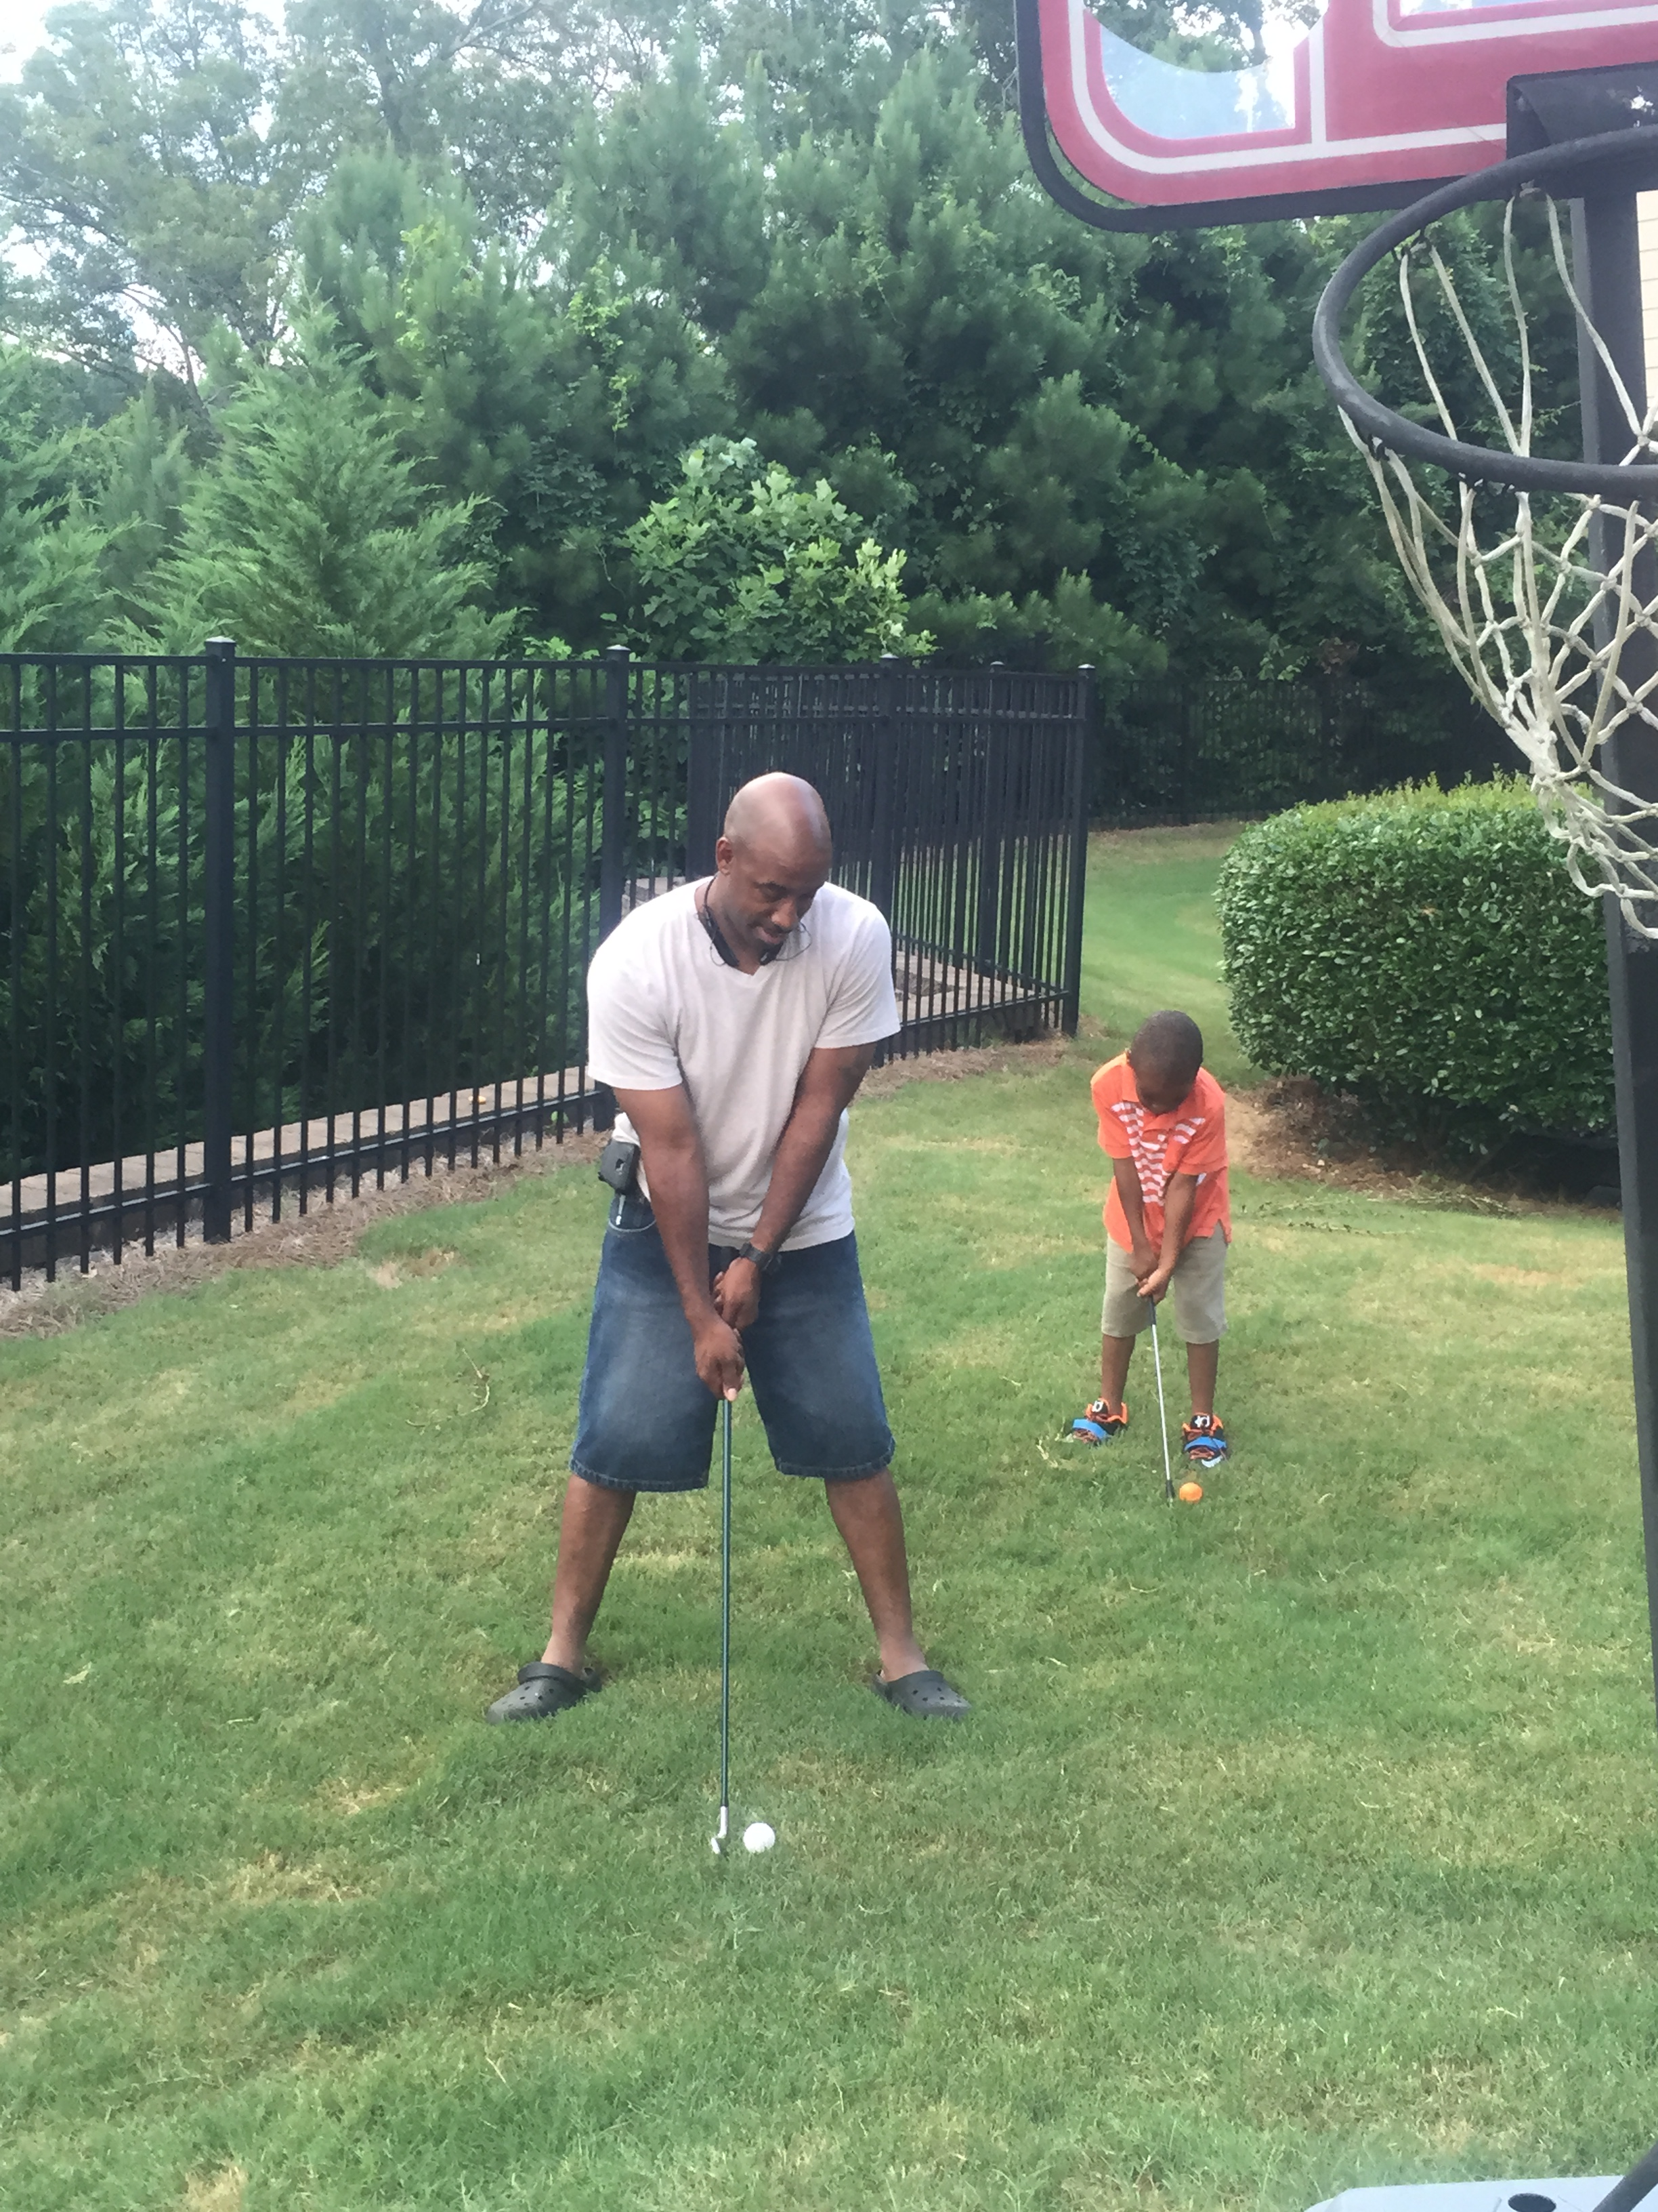
Thank You!!!

