Slide 1
Importance of Research Methodology & Statistics in Ayurveda.

Slide 2
Is research needed for Ayurveda?
When we talk about research in Ayurveda the following question come in to our mind:
Do we need research in Ayurveda?
Whether Ayurveda is scientific?
Whether concept of Ayurveda are to be put under scanner?
Whether the present methodology of research is suited for Ayurvedic concepts?
Do we need to have separate research methodology for Ayurveda?

Slide 3
Whether Statistics is Needed For Ayurveda?
In Ayurveda we come across Statement like “Clinically significant, Statistically Insignificant . Is it scientifically Correct?
Is it Randomization technique Really adoptable in Ayurvedic Research .
If somebody says the concept of statistics are borrowed from samhitas Do you Accept it ?
If somebody says the concept of statistics is not required for Ayurveda Research. Can you justify it?

Slide 4
ಮೊದಲ ಸಂಶೋಧಕನಾರು?
ಅಕ್ಕಿಯೊಳಗನ್ನವನು ಮೊದಲಾರು ಕಂಡವರು?
ಅಕ್ಕರದ ಬರಹಕ್ಕೆ ಮೊದಲಿಗನದಾರು?
ಲೆಕ್ಕವಿರಿಸಿಲ್ಲ ಜಗ ತನ್ನಾದಿ ಬಂಧುಗಳ!
ದಕ್ಕುವುದೆ ನಿನಗೆ ಜಸ? –ಮಂಕುತಿಮ್ಮ!

Slide 5
Statistics- Mathematics
Statistics is the science of collecting and analysing significant numerical data.
Numerical means to deal with numbers. But the numbers are understood in two ways mathematics as well as statistics.
Mathematics gives complete stepwise sets and solution exact and unchanging, leaving no room for accepting errors while statistics keep the possibility of change open and gives solutions in probabilistic manner.
In mathematics if the results differ than expected; then it proves that the method is wrong; but in statistics it is not so.
Statistics is based on the principle of error which deals with the allowable errors involved in experiment. These are natural errors which are irremovable.
Statistics is an applied science and is used in medical science, psychology, engineering, social sciences, economics, and education.

Slide 6
Statistics- Mathematics
In all the three treatises, particularly in Charaka Samhita numerical values are used for particular data.
Right from the beginning of the principles there are numerical values used to denote five mahabhootas, three doshas, three upkramas, three rogamargas, eight mahagada, eight nindita etc.

Slide 7
Statistics- Mathematics
A ‘vaidya’ must be well versed with method of measurement of all the variables like dosha, drug, strength, diet etc. to be able to treat the diseases successfully.
The measure is of three types quantitative [dravyataha], qualitative [gunataha], and combination of both [ubhayataha].
For example, quantity of urine passed by a person in 24 hours is measured using the unit litres while it’s colour, clarity, smell are compared to standards and noted; is an example of application of both types of measurement

Slide 8
Importance
Use of health statistics in public health/ community health.
To draw pin point conclusionfrom observations and results of the strudy.
To determine cause and effect relationship/ corelation between related factors.
Standardization of different methods.
Helpful in planning and programming of public health.

Slide 9
Summary:
There can not be one to one matching of the methods in Ayurveda with those which are practised today.
As mentioned in the introduction there are no separate manuals on ‘how to do research in Ayurveda’ as the manuals or books available today.
This is a effert to analyse whether research thought was prevailing or not in the intelligent class of people practising Ayurveda by using modern day understanding as yardstick.

Slide 10
Relevance of statistics in Ayurveda
‘Sankhyasyath ganitam’
The above quote is from charaka samhita vimana stana where he gives importance to statistics.
Information Numerical Information.
Pain(qualitative data) numerical (quantitative data) by measuring the severity using scale for measurement of pain, Statistical analysis done to interpret the quantitative data into fact

Slide 11
Data collection methodology observed in Ayurveda
Observation method : Indriya sthana
Questionnaire method : Chikitsa sthana
Interview method : Siddhi sthana
All data collection methodologies are there in Samhitha.

Slide 12
Presentation of Data
The sutras are nothing but beautiful presentation of data in a literary form.
Data can be presented in tables and graphs.

Slide 13
Presentation of data in tables
Tabular form
Charaka Samhita in table form:
Sl. No | Class interval f | Mid point X (MP) | Number N
1-Sutra Sthana |  |  | 30
2-Nidana Sthana |  |  | 8
3.Vimana Sthana |  |  | 8
4-Śarira Sthana |  |  | 8
5-Indriya Sthana |  |  | 12
6-Cikitsa Sthana |  |  | 30
7-Kalpa Sthana |  |  | 12
8-Siddhi Sthana |  |  | 12

Slide 14
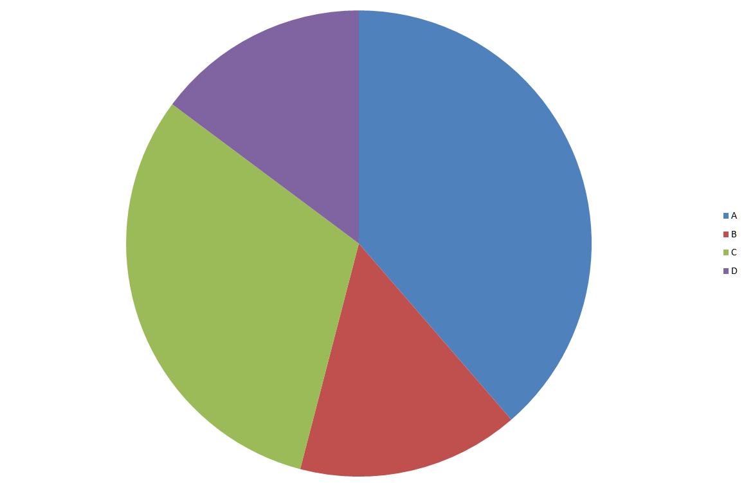
Graph form
‘Yatrashritha karma gunah karanam yat tat dravyam’
Draya = Guna + Karma
Sigma X =X1 +X2
Pie chart

Slide 15
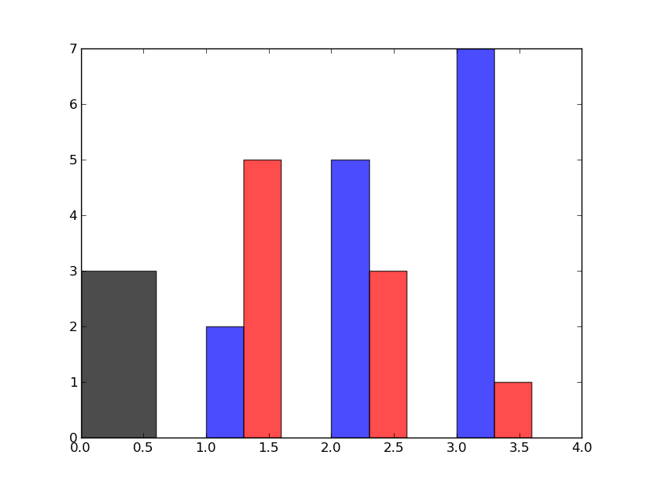
Bar diagram
Guru Ahara
Snigdha ahara
Ruksha ahara
Ushna ahara
Atisara Nidana shloka
Sigma x is not known or infinity.
X1, X2….Xn is known
Bar diagram
Here sigma X is not known hence formula is SigmaX = X1+X2 +X3…….+Xn

Slide 16
Correlation
Suppose x and y are independent variables.
If x is known
If y is known
Then we can analyze correlation between X and y
Eg: Concept of sadhya asadhyata

Slide 17
Regression
Suppose x and y are dependent variables.
If x is known
y is not known
Then we can predict y based on value of x
Eg: Nidana of any disease

Slide 18
Concept of central tendency
There are 500 drugs according to Sushruta’s classification
These are divided into 50 groups.
Each group consists of 10 drugs.
Conclusion:
The above is an illustration of data collection.
Here the Agra Dravya can be considered as MEAN but it may be potency of drug, morphology of drug, availability of drug or ability to make different kalpanas of drug or usage of drug.
On this we have to do research.

Slide 19
Mode
Each group has 10 drugs.
Some of the drugs are common in many groups.
This can be considered as mode.
Nothing but repeated happening or event.
Eg: kaakoli is in Jeevaneeya, brihmaneeya, balya and many other ganas.

Slide 20
Median
Arrangement of data in a chronological order from top to bottom or bottom to top.
Arrangment of vata
Prana vata- Murdha
Udana vata - Urah
Vyana vata -Hridaya
Samana vata- Agni sameepa/ Koshta
Apana vata- Apanagah

Slide 21
Probability
Permutation and combination of rasas into 63 rasas is an example for probability.
Rasa as 1-6
Rasa as 2 combination- 30
Rasa as 3 –
Rasa as 4 -
Rasa as 5 -2
Rasa as 6 -1
63
Probability addition

Slide 22
Normal Probability Curve

Slide 23
Concept of normal probability curve
In charaka samhita charakacharya has given the concept of sadhya asadhyata, where he has divided sadhya, asadhya and further he devides sadhya and asadhya in two groups.
This is the concept of normal probability curve, where in +3 and -3 are 99.63% and it will not touch 100% suppose it touches in infinity.
In the same way parameters are given for sadhya and asadhya, but they are in the range of +3 and -3 because acharya has given exception like roga nava sadhya, exception is rakta gulma which is sadhya if it is purana.

Slide 24
Characteristic Of NPC
It is a bell shaped symmetrical, unimodal curve, tappers on either side in the same fashion,
The mean, mode median are equal & lie on the center.
Can be correlated to Swastha purusha lakshana of Susrutha.
Samadhatu-Mean
Samadosha-Median
Samagni- Mode

Slide 25
NPC Cont’d
~ 68% of observations-mean±1SD.
~95% observations-mean±2SD.
~99% observations-mean±3SD.
touches baseline only in the infinity.
Vataja nanatmaja vikara- 80 (57%)
Pittaja nanatmajua vikara 40 (28%+ 57%)
Kaphaja nanatmaja vikara-20 (57%+28%+14%)
Total 99%
Nanatmaja vikara are not finite, it will not touch the baseline.

Slide 26
Concept of variability
Treatment should be given according to patient’s condition, considering the concept of ‘Dasha vidha pareeksha’.
There is no tailor made prescription for any disease.
The above is concept of variability.

Slide 27
Concept of range
In Vatarakta the concept of range is beautifully explained by dividing the disease according to sthana of dhatu.
Uthana range is-Twak,raktashritah
Gambira range is- from mamsa onwards.

Slide 28
Concept of arithmetic deviation
Prameha chikitsa sutra
Where he divides chikitsa into two
Sthoola pramehi – krisha pramehi
Apatarpana – santarpana
In the next stage Charakacharya says
“Pramehinam Apatarpanam eva kaaryam.”
According to Arithmetic deviation neglect the sign and show the data as whole.
Apatarpana : – ve sign
Santarpana : + ve sign
Neglect the sign and confer the concept. It is nothing but apatarpana.

Slide 29
Concept of test of significance
Chi square test
Test is for to find out association and proportion for qualitative non parametric data.
‘Prameha hetuh kapha krichra sarvam.’
In this context acharya has given Sphecific hethu of aasya sukha, svapna sukha, dadhi etc in particular and he elaborates in saying all kapha kara aharas.
This is the concept of tests of significance. Wherein association is seen for Aasya sukha, svapna sukha, dadhi and proportion is seen for kapha krichra ahara.
But if we consume kapha kara ahara also we will not get prameha and in prameha nidana sthana charakacharya has given one concept that:
“Vikara vighata bhava abhava prativishesha bhavanti”

Slide 30
Concept of percentiles, deciles & quartiles
This concept is also explained in Ayurveda as lakshanika chikitsa where in the treatment is specific to lakshana not for vyadhi.
Eg: Vedana sthapaka & Shothahara drugs used in Amavata
Rajayakshma samprapti -4 causes & 4 sampraptis are examples for quartiles.

Slide 31
TESTING OF HYPOTHESIS
Null Hypothesis- write the statement in a form of protocol.
Yatra yatra dhuma tatra tatra vahni (parvato vahniman dhumatvat)
Null hypothesis should have specification, repeatability & sustainability.
Alternate Hypothesis-
Yatra vahnih nasti tatra dhumo api nasti. (mahahradah)

Slide 32
ERRORS
Type 1 Error: the one which is rightly acceptable is rejected.
Ex- rogabhisara vaidya lakshana.
Nava roga has to be treated but rakta gulma should not be treated.
To rule out type 1 error, Chakrapani classifies it as Vishesha prakarana.

Slide 33
Now justify this assumption “concept of Statistics borrowed from Ayurveda”. Please rise your hand for ‘Yes’.

Slide 34
It reminds me the story of Grape & jackal
We are ignorant About statistics let us learn the treasure which is our own property don’t through it try to grab it

Slide 35
Ignorance of Law has no excuses.
Arise, Awake & try to explore statistics concept in Ayurveda

Slide 36
Thank you

