Slide 1
Welcome to TOT -Medical Officer’s

Slide 2
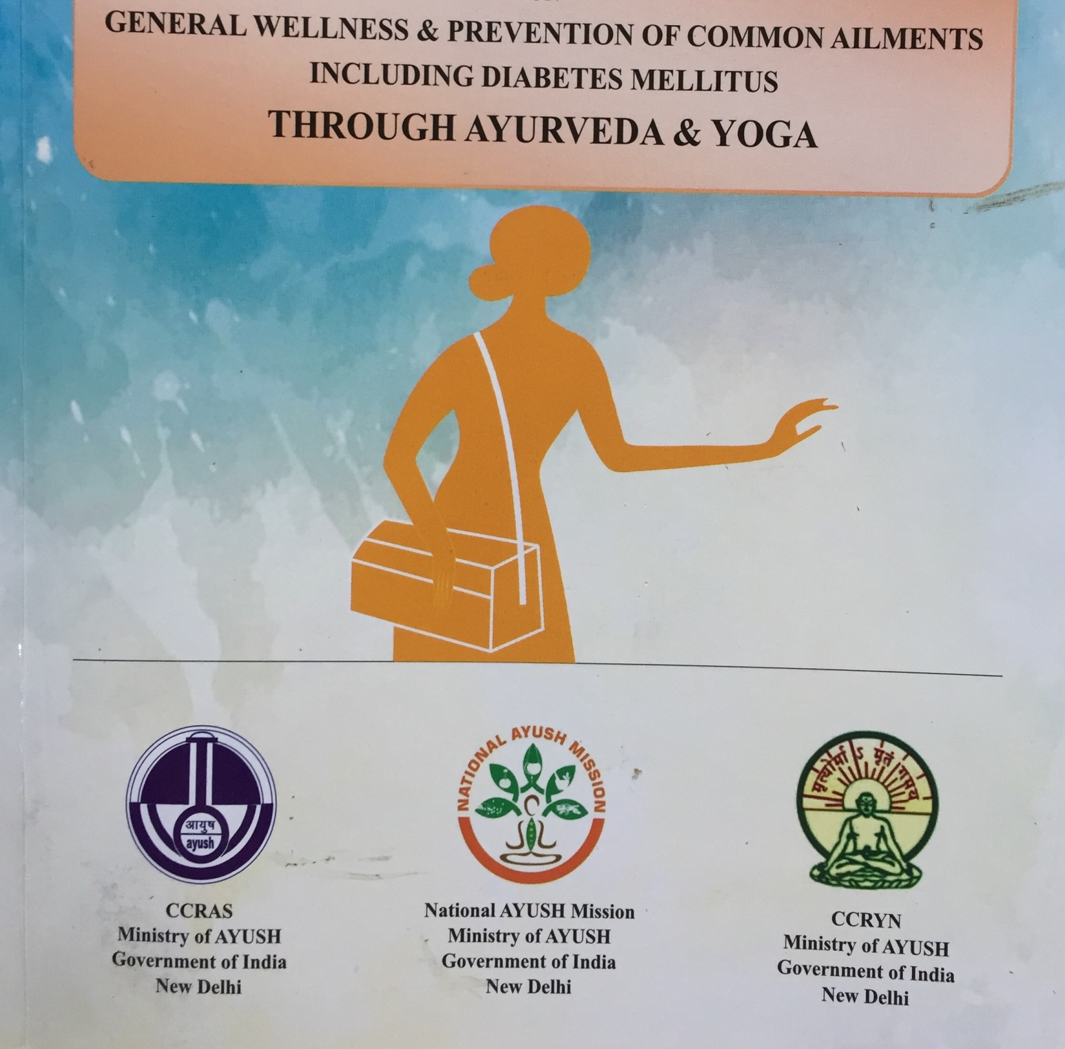

Slide 4
Jala-Water
Quality of Different Jala
Saddharana Jala
Paapodaka
Rogodaka
Amshodaka
Arogyodaka

Slide 5
Jala
Sheeta Jala
Ushna Jala-Types
Contrindication for Ushna Jala
Contraindication for Sheetajala

Slide 6
Jala Paana Vidhi
Alpa Jala Paana-Condition
JalaPaana during Bhojana
Time to drink water
Rtu and Jala
Varsha-Guru + Abhishyanda---1/8th
Sharad-Anabhishyandam Laghu----1/2
Hemantha/Shisira-Guru Snigdha---3/4th
Vasantha ---Kashaya Madhura Rooksha---1/4 th
Greeshma ---Anabhishyanda---1/2

Slide 18
Common Ailments & Management through Home remedies
Common cold
Tulasi Patra and Shunti & Maricha Churna -Kashaya with Madhu
Gragle with Warm water mixed with Haridra churna- to releive sore throat.
Prevention
Keep away from others who are affected
Eat a well balanced diet, Take plenty of hot beverages.

Slide 19
Jwara
Guduchi Kashaya
60 grams of thumb thick pieces add ½ tsp of Shunti-boil with 12 glasses of water , when 3 glass remains cool it, then half glass of kashaya consumed with Madhu.
Malabadhata
5 gms of Thriphala Churna with Warm water at bed time.
Eat plenty of fruits and vegetables as papaya and sugarcane are very effective.

Slide 20
Acidity & Heart burn
Fresh Radish may be added with Tomatoes and Carrot
3 gms of Ajamoda with liitle salt
A tiny piece of Jaggery kept in mouth and slowly sucked.
10ml Kashaya of Haritaki after food
Dried blossom of tulasi + Twak of shigru tree+ Maricha + Pippali – are taken equal quantity and powdered well and consumed mixing with water . Dose: 3 gms Twice daily.

Slide 21
Diarhhoea
Dried powder of Pomegranate fruit twak 5-10 gms with Honey. Dose: 4 times a day.
5 gms of Dried Powder Bilwa Phala Twak mixed with 100-250 ml of Buttermilk. Dose: 4 times a day.
5 gms of either Fried Jiraka /Pippali / Shunti mixed with 1 litre of Buttermilk, consumed in 24 hrs.
General Precautions: Babies are provided with lot of Liquid foods like Sharabat, tender coconut, rice kanji and ORS Liquids and other locally accepted liquids.
Note : Medical help is always required when bloody Diarhhoea occurs.

Slide 22
Menstrual cramp / Pains
5-7 Garlic pods (Grinded) in a glass of buttermilk or lemon juice and consumed
Extract juice of Aloe vera . Dose : 1 tsp per day
30ml Kashaya made of Black tila, Shunti and Aloe vera consumed with Jaggery , twice daily.
Note : It is important to wash outer genitals with luke warm water every time while changing sanitary pads.
Avoid fried food, pulses and sour items and that would cause constipation, especially during last week of MC

Slide 28
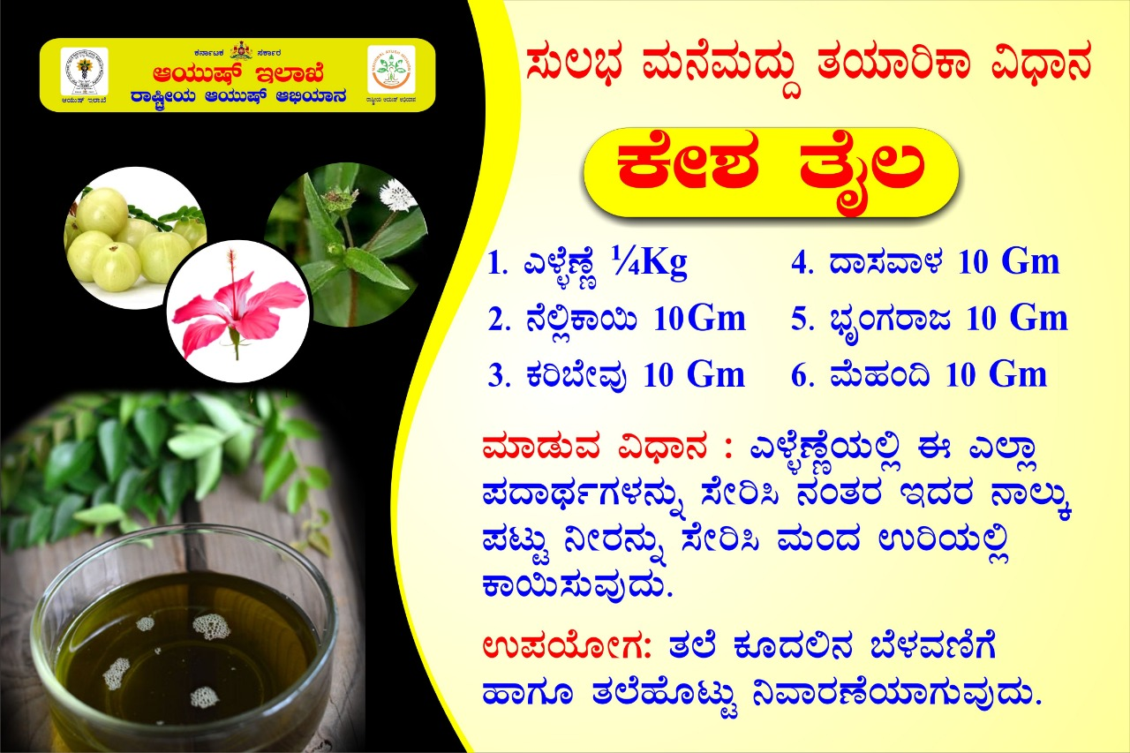

Slide 30
Useful Ayurveda herbs for Diabetes
Svarasa of Guduchi 15-30 ml Thrice daily
Madhunashini Powder 3-6 gms Thrice daily
Palasa Powder 10 gms ,Thrice a day
Jambu seed powder 3-6 gms thrice a day
Methi powder 3-6 gms with water twice a day
Amalaki churna 3-6 gms with water twice a day

Slide 31
Patola + Nimba Patra + Guduchi kashta-kashaya 15-30 ml twice a day
Daruharidra Kashaya + Thriphala churna
Sariva stem powder + Yashtimadhu

Slide 32
The Do’s in diabetes
Diet planning
Intake of Barley, green gram, old rice, whole wheat floor ,bitter gourd, drumstick ,green leafy vegetables , Meethi snake gourd , pumpkin , garlic , turmeric, cucumber watermelon, butter milk and fruits like Guava , oranges, Indian blackberry etc are beneficial in diabetic patients.
Ayurveda emphasizes on daily regimen that is Dinacharya and seasonal regimen that is Rtucharya and timely intake of diet.
Daily exercise or increased calorie consuming activities that is walking swimming etc
Reducing stress by yoga and meditation yoga Pashimottasana Haalasana etc are beneficial for diabetic patients.
Restrict and reduce weight
Regular use of Rasayana drugs like Guduchi and Amalaki
Blood sugar to be checked regularly and if they are high then consult a doctor and follow advice after 40 years blood sugar should be checked regularly if person is overweight the blood sugar should be checked even before the age of 40 years.

Slide 33
Special note
Take advice of Dr for regular tests example kidney function test eye examination etc
Take utmost care of personal hygiene especially of feet and hand
Don’t stop or change medication on your own or advice of friends

Slide 34
Dont’s in Diabetes
Intake of rice sugar or sugar products dairy products like sweets ice cream chocolate candies fried food junk food aerated drinks pizzaas burgers and other kinds of fast food potatoes sweet potatoes fruits with high sugar example grapes mangoes banana and any processed foods.
Sedentary lifestyle
Sleeping during daytime and excessive sleeping
Smoking tobacco alcohol

Slide 35
Complications of diabetes mellitus
Involvement of major blood vessels causing heart diseases
Involvement of small blood vessels causes diabetic complications in the retina , kidney and neutrons
The patience of diabetes are more prone to infections
Referral criteria
Diabetes which pregnancy
Diabetes with complications like diabetic foot ,coronary artery disease , diabetic nephropathy diabetic neuropathy diabetic retinopathy and renal failure
Patience with severe infection marked weight loss and breathlessness.

Slide 37
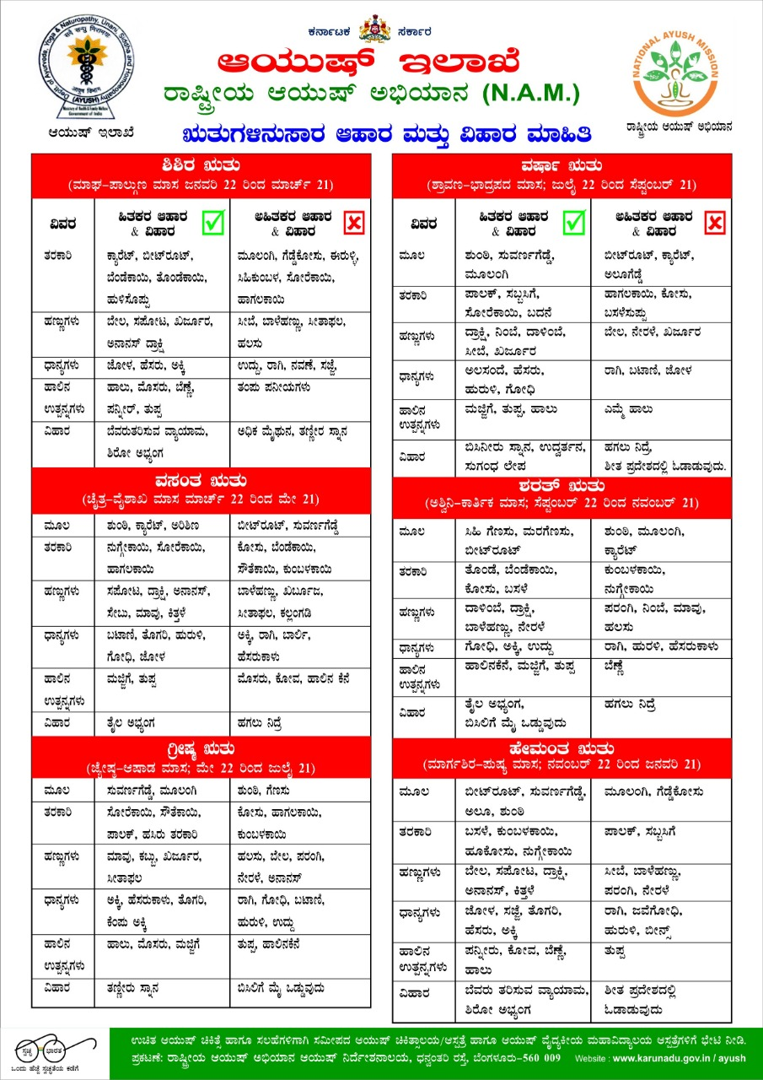

Slide 38
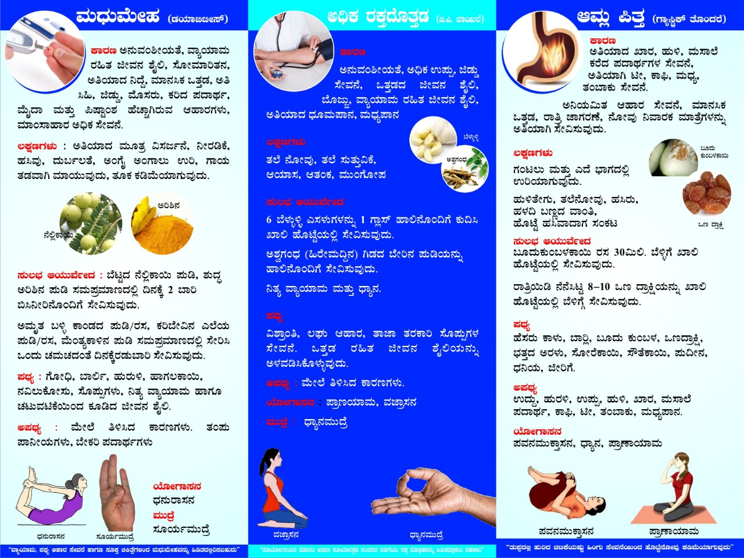

Slide 41
